Slide 1
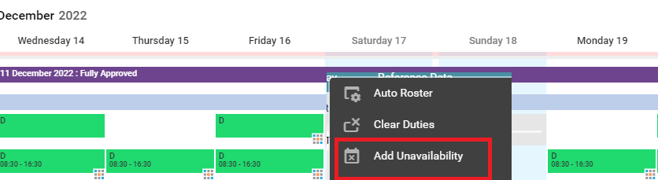
How to record Industrial Action on Health Roster
Right click on the date you wish to add the unavailability.
Select “Add Unavailability”.

Slide 2
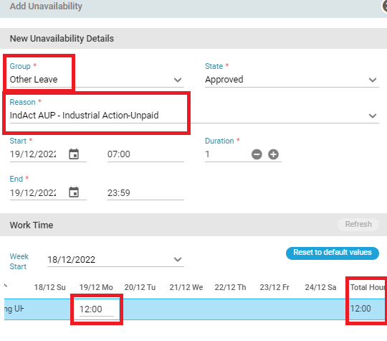
How to record Industrial Action on Health Roster
Select the group as “Other Leave”.
Select the reason as “IndAct AUP – Industrial Action-Unpaid.
Verify that the hours recorded match the hours the person would have worked on that day.
Click “OK” to save.

Slide 3
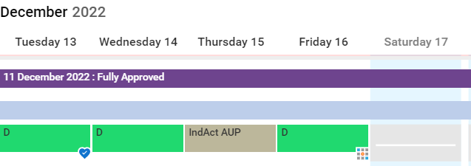
How to record Industrial Actions on Health Roster
The unavailability will be recorded as above on Health Roster.
Once recorded, the person will not be paid for the shift and ESR will be updated.

