Slide 1

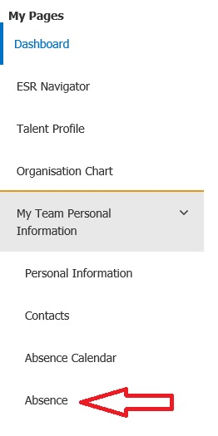
How to record Industrial Action on ESR Manager or Supervisor Self Service
Log into ESR at Home - ESR Hub - NHS Electronic Staff Record.
Select the ‘Manager’ or ‘Supervisor’ (dependent upon allocated access) tab at the top of the screen.
From the ‘Manager’ or ‘Supervisor’ My Pages list select ‘My Team Personal Information’, and then ‘Absence’.

Slide 2
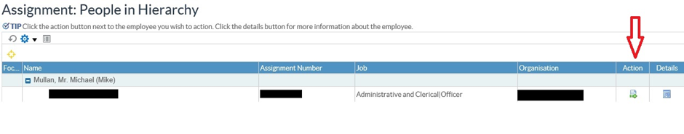
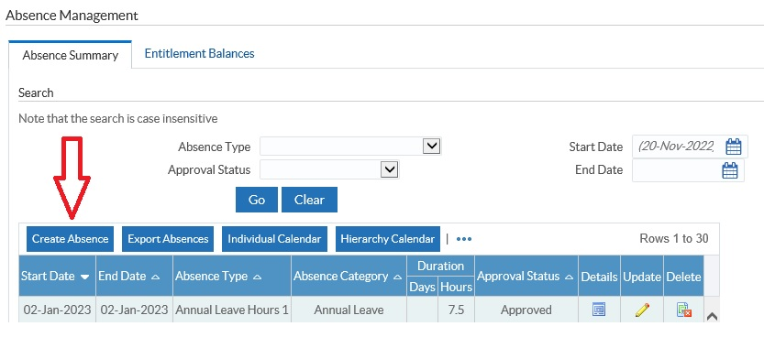
How to record Industrial Action on ESR Manager or Supervisor Self Service
The screen displayed shows the people in your assigned hierarchy, for whom you have administrative responsibility within ESR. Click on the ‘Action’ icon to the right of the name of the person for whom you wish to record industrial action absence.
The next screen displayed, Absence Management’ shows the current leave record in ESR, and provides the option to Create Absence.

Slide 3
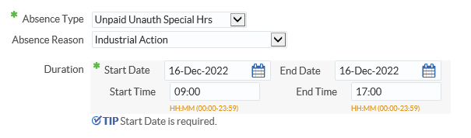
How to record Industrial Action on ESR Manager or Supervisor Self Service
In the ‘Create Absence: Enter Absence Details’ screen, select ‘Unpaid Unauth Special Hrs’ for the Absence Type, and ‘Industrial Action’ as the Absence Reason. The Start time and End Time (in the format 00:00 – 23:59) is also required, as the start and/or end time of the shift may not coincide with the duration of the industrial action.
Once the details have been correctly recorded, click ‘Submit’. For reference this process is virtually the same as the process for recording sickness and annual leave in ESR.

