Slide 1
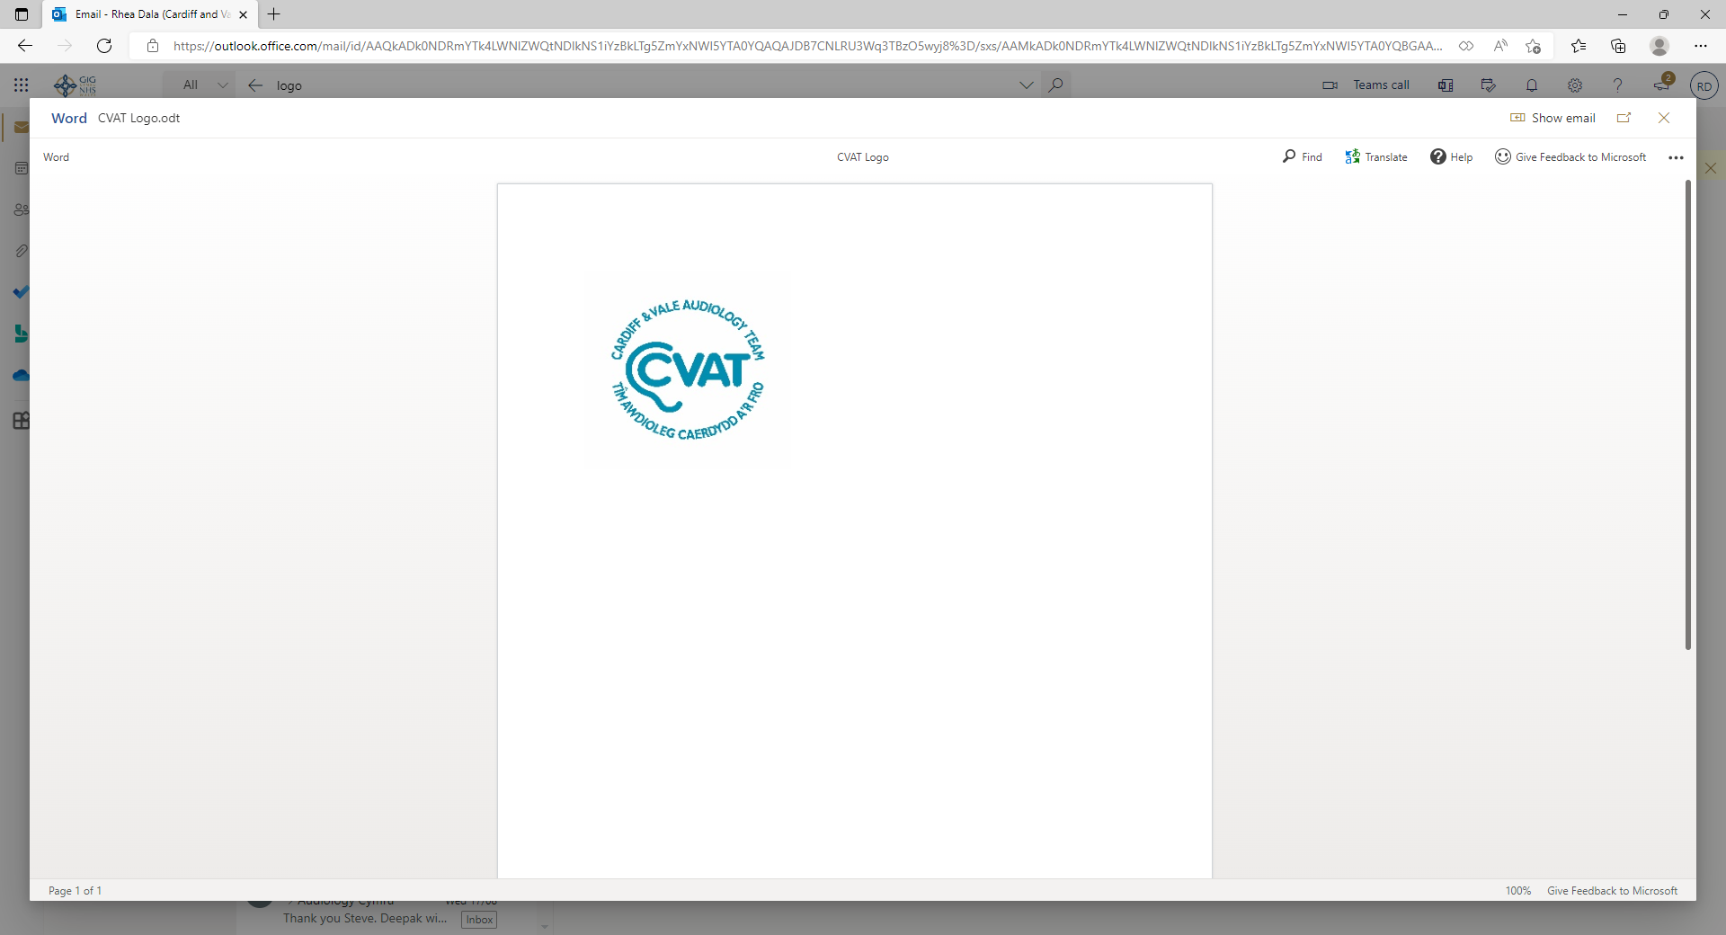

Adult Audiology Services
Service User Feedback 2022
100 questionnaires were given out to Adult Audiology Service users in Cardiff and the Vale during August 2022. We received 100 responses and the results are shown below.
ACCESSIBILITY
Responses were generally very positive with regards to communicating with the department, waiting times for, and at, appointments, postal service for repairs and batteries and the issue of a years supply of batteries.
‘System has long waiting time.’
‘Apart from the waiting time for a hearing test, your department is fantastic.’
Our Response:
We have currently employed locums to ease the waiting lists times.
SURROUNDINGS
There was a high level of satisfaction reported with regards to the welcome received at reception and the appearance and comfort of rooms. With 4% of patients reporting that they were somewhat dissatisfied/very dissatisfied.
‘The receptionist was amazing and so was Eve.’
‘The departments consulting rooms needs better air flow to keep them cool and more comfortable for all including staff.’
‘Waiting room too hot .’
‘Maybe easier hearing from reception staff as the screen is in the way’
Our Response:
The screens can be potentially removed with easing of further restrictions we are also updating/replacing loop systems for both reception desks and introducing new loop systems to all repair rooms. All staff will receive training in their use.
We are currently in the process of having air conditioning installed in the clinic, this project is ongoing.
INFORMATION
There was a high level of satisfaction with regards to written and verbal information received.
‘My therapist spent time and explained everything in great detail. I could not do without her.’
‘Good care and well explained.’
‘Very thankful for all the help given. Rebecca who saw me today was excellent and very professional.’
‘Emily and Lucy made me feel very comfortable and informed when having my hearing aids.’
Our Response:
We have recently updated written information patients are given. This includes our repair leaflets and hearing booklets which now include a QR code for online tutorials for at home hearing aid servicing. Our letters now have a map with directions to different audiology clinics.
STAFF CARE & TREATMENT
An extremely high level of satisfaction with the professionalism of staff was reported, with 100% of respondants reporting they were ‘very satisfied’. Responses were generally very positive with regards to the opportunities to discuss problems or difficulties, help with hearing and ability to hear their name called in the waiting room.
It was very pleasing to get some positive comments with regards to overall care and treatment received:
‘Superb – long live audiology!’
‘Thank you for your excellent care.’
‘All the staff i have had to deal with in this department have been exceptional. Thank you all so much.’
‘Excellent!’
‘Excellent effcient service.’
It was very pleasing to know that such a high percentage of respondents are very satisfied with the overall Adult Audiology Service received. All negative comments are taken seriously and will form next year’s action plan for service improvement.
For further information or comments, please contact Lorraine.lewis4@wales.nhs.uk

