Slide 1
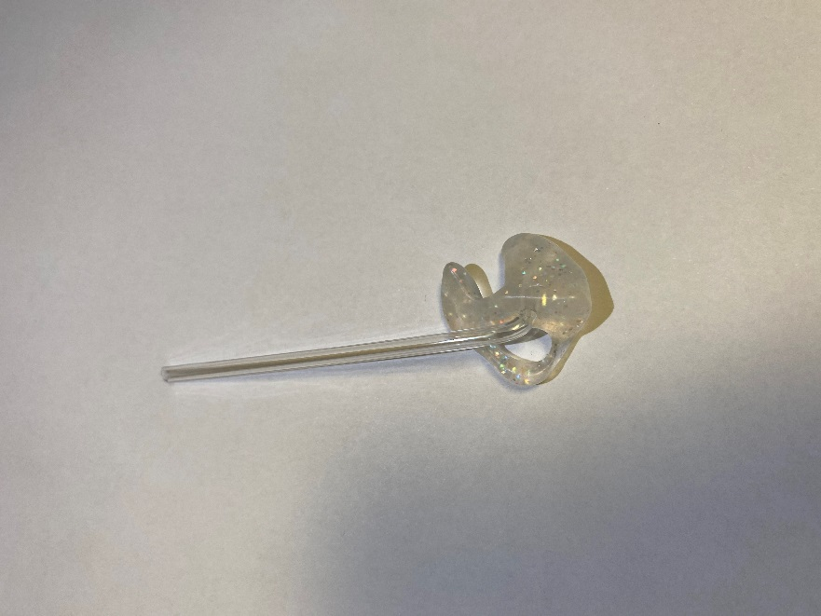
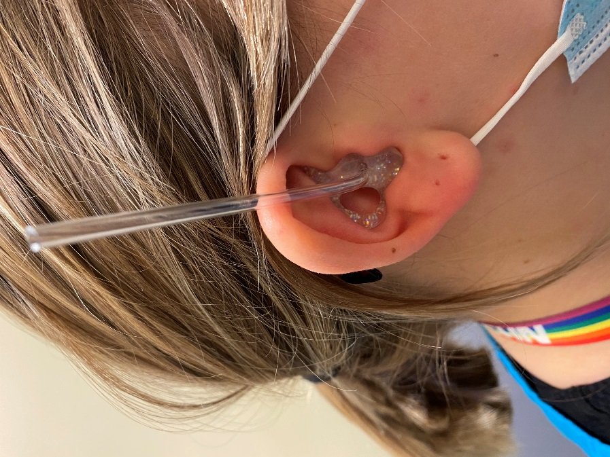
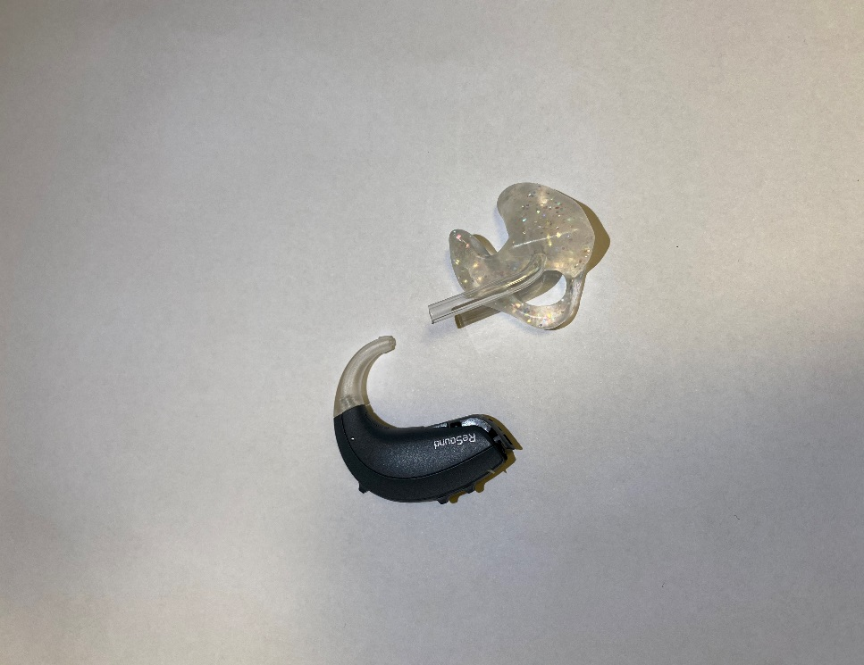
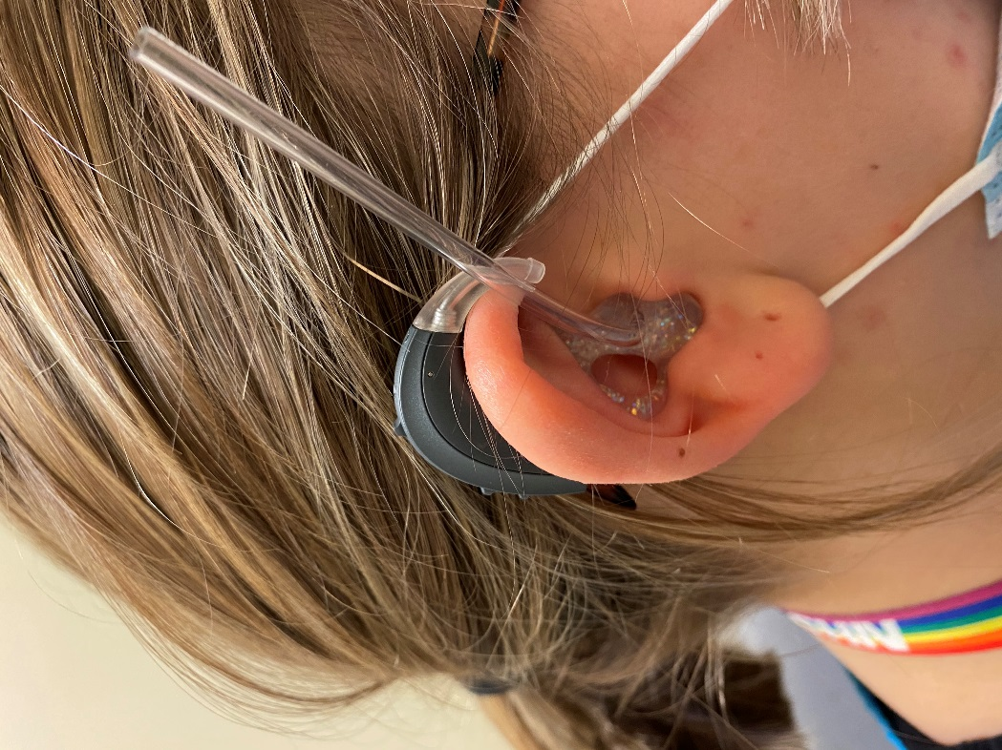
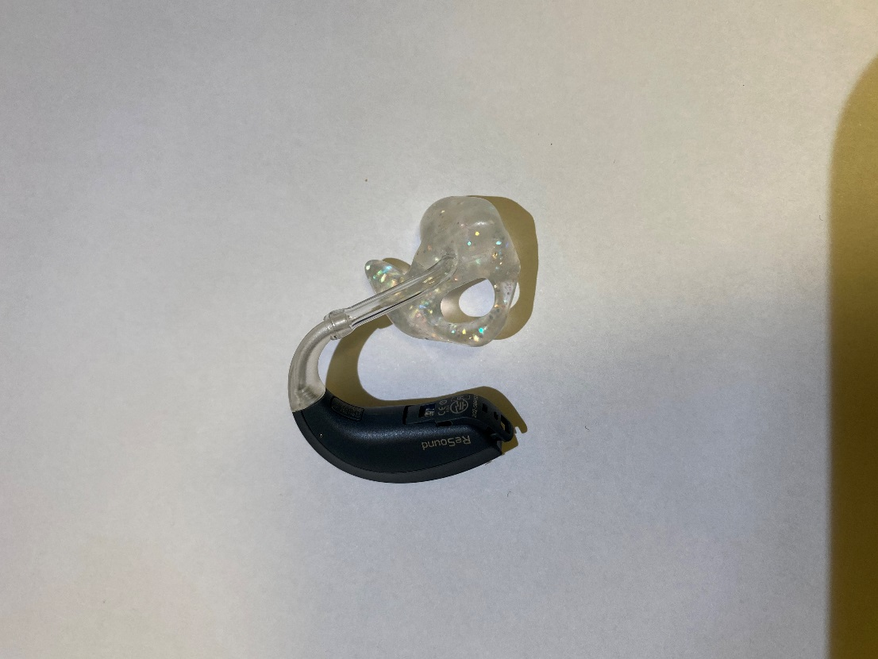
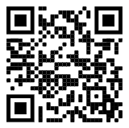

I
F
F
A
U
D
O
L
O
G
Y
I
How To Trim Earmould Tubing
D
T
R
E
A
A
C
M
V
AT
T
O
I
R
M
F
A
^
R
’
W
D
A
D
I
D
O
L
E
G
C
A
E
R
D
Y
Step 1: Your earmould will have long tubing, like this
Step 2: Put the earmould in your ear, ensuring you insert it correctly.
Step 3: Put the hearing aid behind the ear, mark the point where the hearing aid meets the tubing (see arrow)
Step 4: Trim the tubing to the marked length and then connect the tubing to the hearing aid elbow (hook)
Please note:
If you cannot fit your earmould yourself, please attend our walk in service and bring your new earmould and your hearing aid along with you.
UHW (Cardiff)
Monday - Friday (excluding bank holidays)
9am-12pm and 1.30pm-4pm
West Quay Medical Centre (Barry)
Tuesday & Thursday only
9am-12pm and 1.30pm-4pm
Please take a number and a seat
For a video guide scan the QR code or search ‘How to Cut the Earmold Tube on
your Hearing Aid’ on YouTube.
Audiology Clinic
Clinic 9, Outpatients
University Hospital of Wales
Heath Park Way
Cardiff
CF14 4XW
Tel: 029 218 43179
Mobile (Text Only): 07805 670 359
Email: Audiology.Helpline.CAV@Wales.nhs.uk
Notes:
Colours (RGB):
Blue Text = 0 130 155
Turquoise Background = 170 219 207

