Slide 1
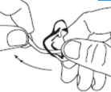
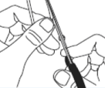
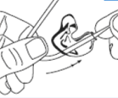
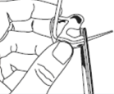
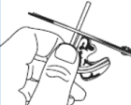
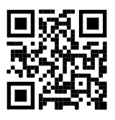

I
F
F
A
U
D
O
L
O
G
Y
I
How to retube your hearing aid
D
T
R
E
A
A
C
M
V
AT
T
O
I
R
M
F
A
^
R
’
W
D
A
D
I
D
Step 1
Step 2
O
L
E
G
C
A
E
R
D
Y
Pull the old tubing out of the ear mould. Save the old tubing for step 5.
Taper 5cm (2 inches) of the tubing.
Step 3
Step 4
Thread the tapered end through the ear mould, pulling the tube until the bend reaches the mould.
Cut the tapered tubing as close as possible to the earmould.
Step 5
Measure the new tubing against the old tubing. Cut the end to the same length. The tubing can now be attached to the hearing aid. Throw the old tubing away in the bin.
For a video guide, visit the Betsi Cadwaladr University Health Board Audiology Department website where they have a number of videos, or scan the QR code.
Audiology Clinic
Clinic 9, Outpatients
University Hospital of Wales
Heath Park Way
Cardiff
CF14 4xw
Tel: 029 218 43179
Mobile (Text Only): 07805 670 359
Email: Audiology.Helpline.CAV@Wales.nhs.uk
Notes:
Colours (RGB):
Blue Text = 0 130 155
Turquoise Background = 170 219 207

