Slide 1
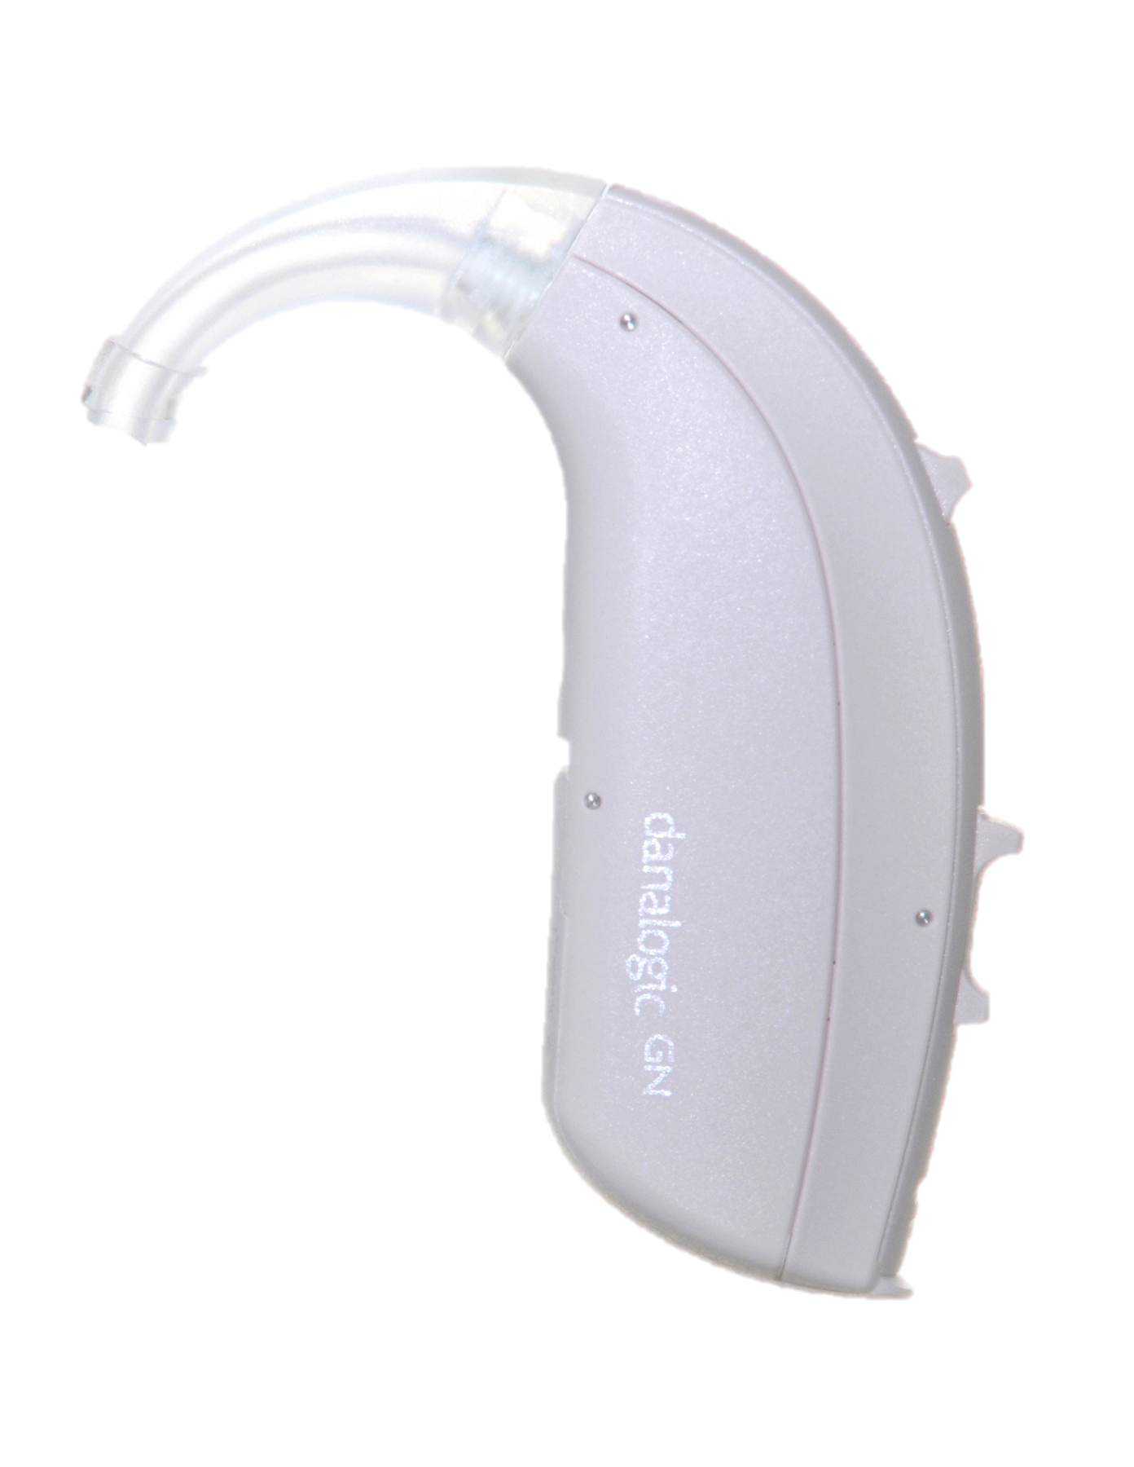
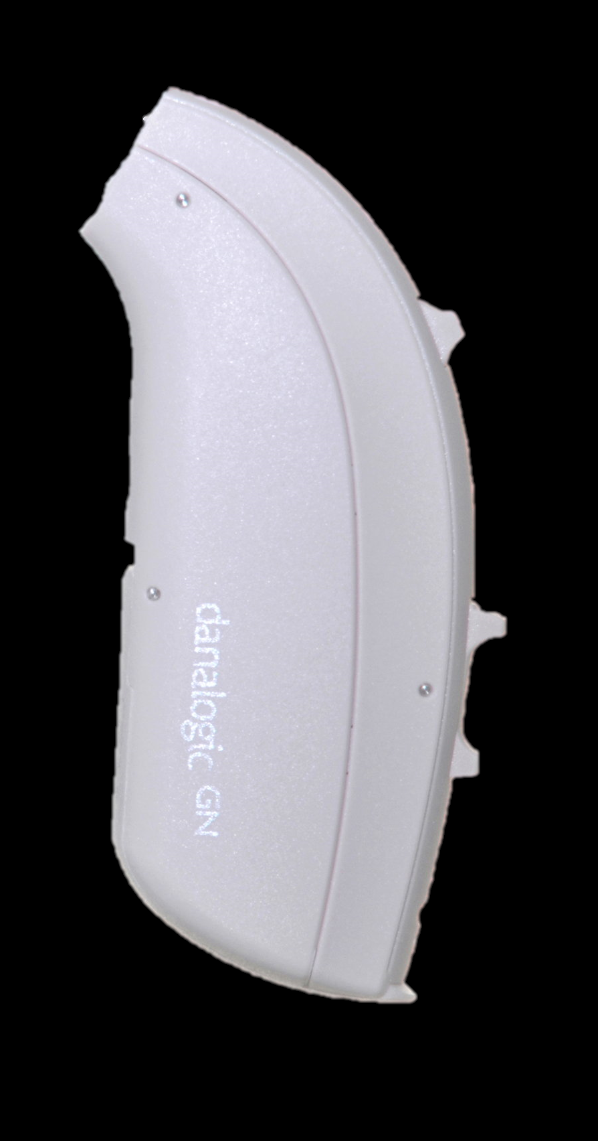


I
F
F
A
U
D
O
L
O
G
Y
I
How to Change an elbow
D
T
R
E
A
A
C
M
V
AT
T
O
I
R
M
F
A
^
R
’
W
D
A
D
I
D
Step 1
O
L
E
G
C
A
E
R
D
Y
Below is the existing hearing aid with the elbow. To remove the elbow unscrew this from the hearing aid.
Elbow
Step 2
Screw the new elbow on to the hearing aid.
Step 3
Make sure the elbow is fully screwed. Throw the old elbow away in the bin.
The hearing aid can now be attached to the tubing.
Audiology Clinic
Clinic 9, Outpatients
University Hospital of Wales
Heath Park Way
Cardiff
CF14 4xw
Tel: 029 218 43179
Mobile (Text Only): 07805 670 359
Email: Audiology.Helpline.CAV@Wales.nhs.uk
Notes:
Colours (RGB):
Blue Text = 0 130 155
Turquoise Background = 170 219 207

