Slide 1
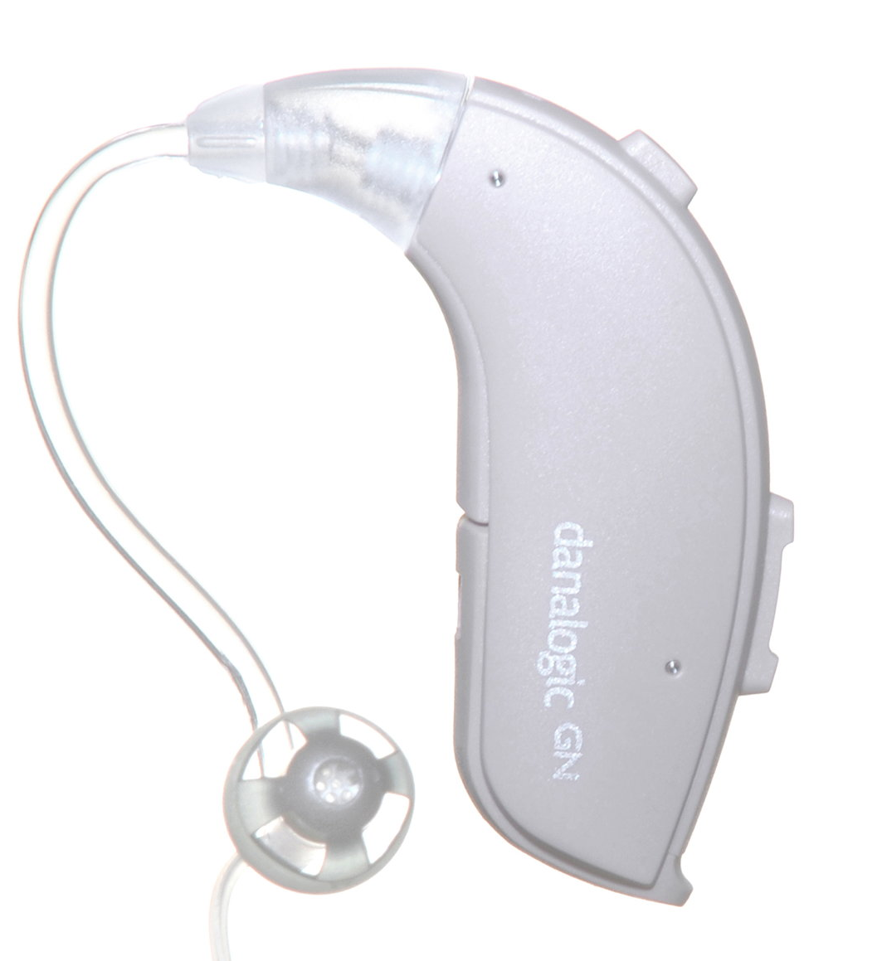
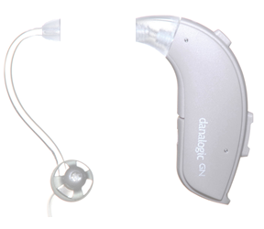
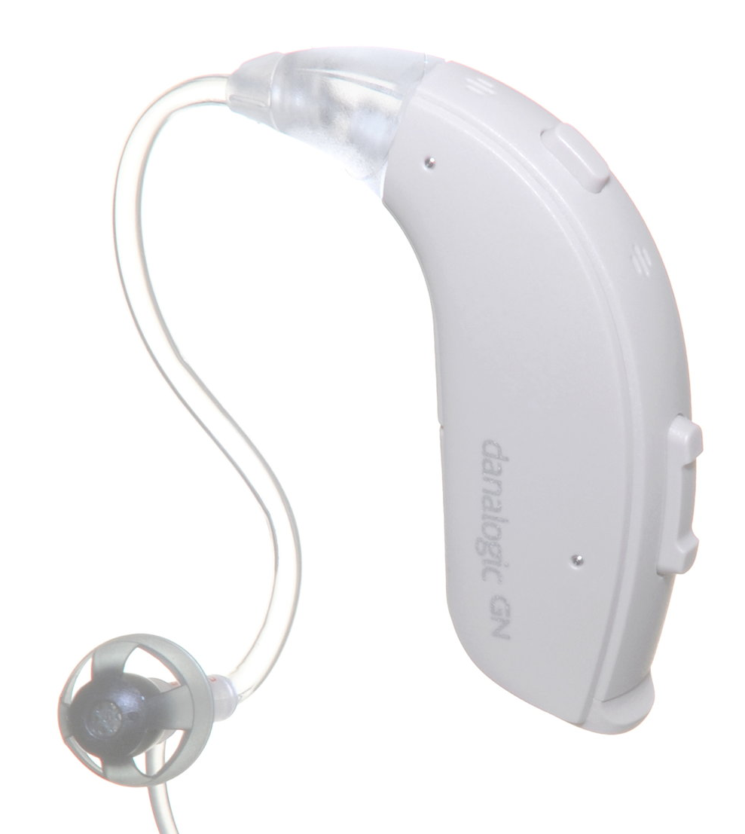


I
F
F
A
U
D
O
L
O
G
Y
I
How to Change Your Thin Tube
D
T
R
E
A
A
C
M
V
AT
T
O
I
R
M
F
A
^
R
’
W
D
A
D
I
D
Step 1
O
L
E
G
C
A
E
R
D
Y
Unscrew the old tubing from your hearing aid.
Make sure you do not remove the ‘adapter/hook’.
Step 2
Check that the new tube is for the correct side.
Remember that:
Red = Right
Blue = Left.
Step 3
Screw the new tubing on to your hearing aid. Throw the old tubing away in the bin.
For a video guide, visit the Betsi Cadwaladr University Health Board Audiology Department website where they have a number of videos, or scan the QR code.
Audiology Clinic
Clinic 9, Outpatients
University Hospital of Wales
Heath Park Way
Cardiff
CF14 4XW
Tel: 029 218 43179
Mobile (Text Only): 07805 670 359
Email: Audiology.Helpline.CAV@Wales.nhs.uk
Notes:
Colours (RGB):
Blue Text = 0 130 155
Turquoise Background = 170 219 207

