Slide 1
Cardiff and Vale University Health Board
Values Based Appraisal
Let’s talk about potential

Slide 2
Session Outcomes
Learn more about the new appraisal process and how it impacts you

Slide 3
Vision
Access to opportunities, exposure, stretch & development to reach your potential
Currently or for the future
The right people in the right roles with the right values
Cardiff & Vale UHB want to develop and nurture engaged and motivated staff with the skills and confidence to live up to our values every day.
Notes:
As a member of staff, you are our most important asset, and as an organisation Cardiff & Vale UHB want to develop and nurture engaged and motivated staff with the skills and confidence to live up to our values every day. Cardiff & Vale UHB is a values based organisation and as such has developed staff support around these values, recognising the importance of the behaviour of staff demonstrating the values that have been set.
Values Based Appraisal (Appraisal) is for everyone and is a focussed conversation around development and recordable outcomes for staff. Your appraisal should cover the development you need, the value you bring, and the position(s) that best suit your skills now and into the future.
Conversations about values, behaviours and performance are an important means of communication and should happen at every meeting between managers and staff but the annual Appraisal is designed to reflect on progress over a longer period and map out the future.

Slide 4
What’s new
Preparation
Focus of the conversation
Measurement against values and behaviours
Links with succession planning
Link with pay progression
Recording on ESR
Notes:
Why are we moving away from PADR? Why is there a need?

Slide 5
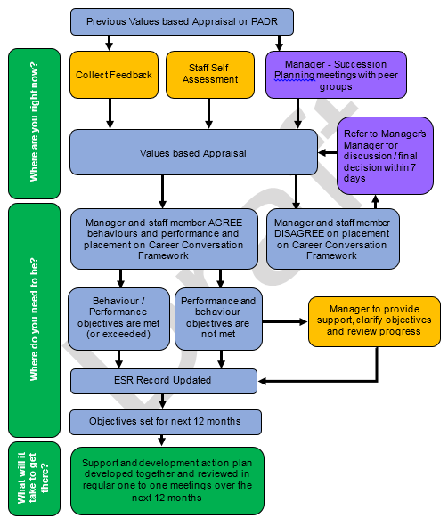
Process

Slide 6
What is Values Based Appraisal
You and your manager are able to have open and constructive career conversation that includes where you are now, where you want to be, and how to be supported to get there.
Notes:
As a member of staff, you are our most important asset, and as an organisation Cardiff & Vale UHB want to develop and nurture engaged and motivated staff with the skills and confidence to live up to our values every day. Cardiff & Vale UHB is a values based organisation and as such has developed staff support around these values, recognising the importance of the behaviour of staff demonstrating the values that have been set.
Values Based Appraisal (Appraisal) is for everyone and is a focussed conversation around development and recordable outcomes for staff. Your appraisal should cover the development you need, the value you bring, and the position(s) that best suit your skills now and into the future.
Conversations about values, behaviours and performance are an important means of communication and should happen at every meeting between managers and staff but the annual Appraisal is designed to reflect on progress over a longer period and map out the future.
The key element to any successful Appraisal in maximising your potential is when you are able to have open and constructive conversation with your manager to discuss; where you are now, where you want to be, and how to be supported to get there.
Values Based Appraisal is one part of Cardiff & Vale’s Succession Planning Strategy and as such links directly to the organisations vision and strategic objectives.
The formal Appraisal is not ‘in addition’ to management responsibilities – it is a fundamental part of every manager’s responsibility and every staff member is entitled to an annual review. Appraisal is part of ‘how we do things around here’ with everyone taking personal responsibility for the success of the organisation as a whole, not just individual jobs or areas.

Slide 7
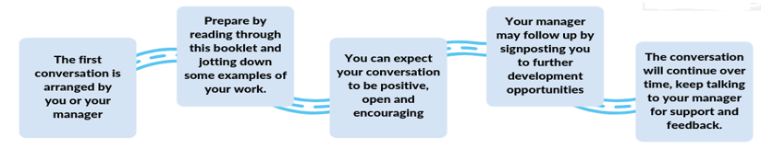
What to Expect
Managers
  Prepare
  Provide advice / paperwork
Staff
  Prepare
  Research development

Slide 8
Preparing for the Appraisal
We all need to feel that we are listened to, understood and valued in our roles to achieve our maximum potential.
Values Based Appraisal is about considering everyone as an individual and the development that is right for them.
The following preparation is best practice and will enable both you and your staff to get the most out of your conversation.
  Self-assessment tool results page
  Feedback from a range of people
  Appraisal Guidelines
  Examples of work
  Any other documentation that may be useful; previous objectives, KSF outline, job description and person specification.
Notes:
They will collect this evidence – you will need to guide them as to who / how / when.

Slide 9
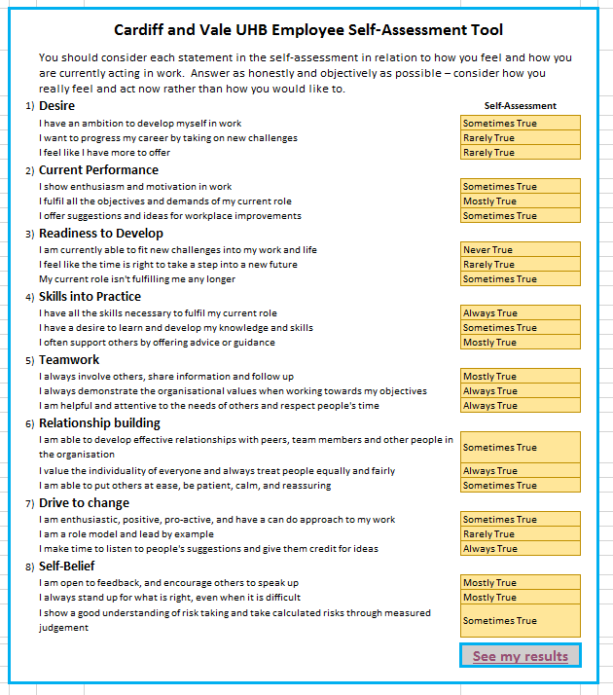
Self Assessment Tool
The self-assessment explores how you are feeling against 8 scales;
Your desire or ambition to develop yourself, either within your current
role or in another area
How well you are currently performing in your work role, including whether
you are enthusiastic and motivated to complete the tasks needed.
Whether now is the right time for you to take on new challenges and
demands that would come with developing your skills or role – are you
ready now, or would it be better to wait for a better time in your life
Whether you have the current skills necessary to fulfil your current role,
whether you want to develop new skills and how freely you use your
expertise to offer support to other colleagues
To what extent you ‘live’ the Health Board’s values and behaviours when
interacting with your team and other stakeholders and to what extent
you demonstrate those values to meet your objectives.
How you use your values and behaviours to develop relationships with
internal colleagues and external stakeholders.
Your motivation to offer ideas about how to make improvements in work,
lead change and encourage others to continually improve.
The way that you feel about your skills, abilities, appearance and behaviour and whether you trust that you can complete tasks to a good standard
The principle behind this is that you should score above the orange line on all scales for you to have a strong case for immediate development and progression.

Slide 10
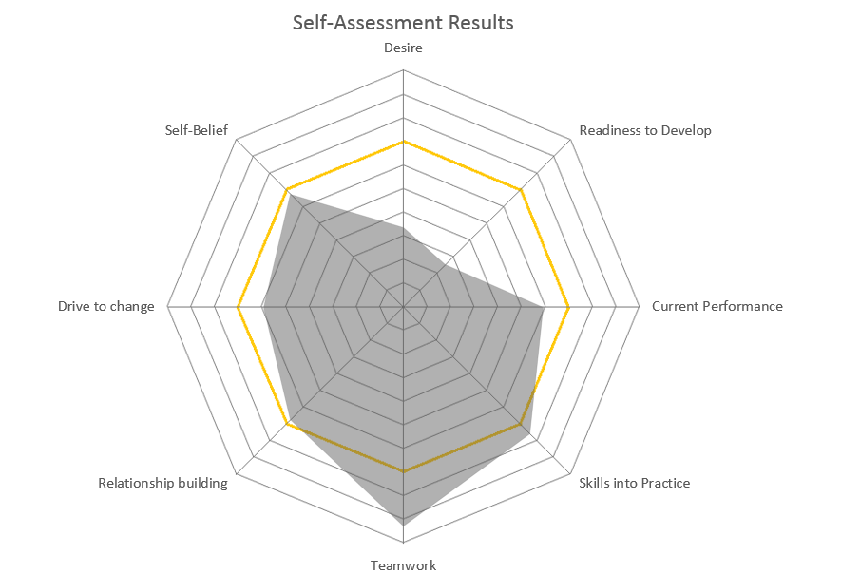
Self Assessment Tool

Slide 11

Getting Feedback from others
How would you know what other people think about your work?
Who would you ask?
What questions would you ask?
What would you worry about?
Notes:
GROUPWORK

Slide 12
Getting Feedback from others
Ask colleagues
Ask straight away
Consider what’s been said
Take what you need to your appraisal
Notes:
Getting feedback isn’t always easy but it is worthwhile. Clearly, the thought of requesting feedback on your work can be scary. After all, constructive criticism can be hard to accept, especially when you’ve done your best. Just remember, good feedback is what will help you improve your performance and enhance your skills.
Ask colleagues
Asking colleagues for feedback means you get a wider picture of yourself – not just what your manager sees. Asking each person for constructive criticism on specific things will allow you to form a good overview of your behaviours and performance. Be brave and don’t just ask those who you know will say nice things. Compare your self-assessment with their comments.
Ask straight away
It’s good to speak to people about your work while it’s still fresh in their minds, not just when your appraisal is due. That way, they’ll be in a better position to remember what you’re talking about without having to go back and review it again. The easier you make it for them to help you, the more useful the feedback will be.
Consider what’s been said
Think about the feedback you’ve received and ask yourself if there is any truth in it. Even if you were amazing, you will want to think about how you can repeat that. While it’s great to receive positive feedback, you’re more likely to learn from feedback that shows you where you can improve. Concentrate on the message, not the way it’s being said or who’s saying it. Some people have a more tactful way of expressing themselves than others, but they’re not the only ones with useful feedback. Always thank the person and say you’ll take his or her feedback under consideration.
Take what you need to your appraisal
The more feedback you get, the more useful it will be. Start with one or two people and get more as you gain confidence. Your manager will be eager to hear about how you’ve used your feedback to improve through the year. Even if it’s negative, they are there to support you and help you discover how to improve. Ask them for help during the discussion.

Slide 13
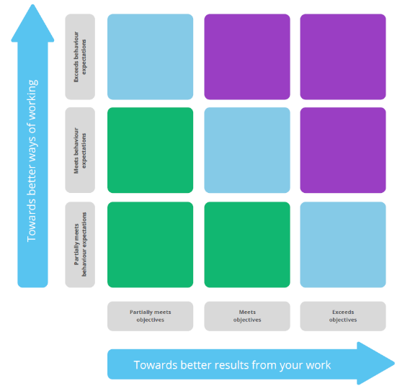
Career Conversation Framework
Designed to enable a conversation about your role in the NHS and plot your position and direction.
Agree together where they’re placed on the framework.
Many of the staff in our organisation will find themselves at the centre meeting performance outcomes using the right values and behaviours.
If they start to move away from the centre, it may mean they need a new challenge or are ready for a new stage in their career.

Slide 14
Using Evidence
As you write and talk about where they are now, there are a number of different things that can help you evidence values and behaviours / performance;
  Answers to the coaching questions
  Feedback from others
  self-assessment results
  previous objectives and how they were completed
  KSF outline, job description and person specification
  Examples of projects or work completed

Slide 15
Using Evidence
What do you consider are the most important aspects of your present job?
What do you believe you have accomplished in the past year?
How do you feel about your performance & behaviours over the last 12 months?
What do other people say about you and what you bring?
What motivates you and makes you feel valued at work?
What do you find most interesting in your job?
What gets in the way of you doing a good job?
What changes should be made so that you can achieve your objectives in the year ahead?
What ambitions do you have for the future? What do you see as your next move? Or are you happy what you are doing?
What do you suggest you need to learn or have experience of in the year ahead?
Notes:
Not all the questions will be relevant to you and your manager might want to change them or add more to make them more suitable for you. You don’t have to answer everything but the more information you include, the better the discussion will be.

Slide 16
Rating your performance
How to rate your values and behaviours / performance……..
 | What does this look like to others?
Rating | values and behaviours | performance
Partially meets expectations | You can show evidence that you sometimes use the values and behaviours in your work but there are times, such when you are stressed, when you sometimes behave in ways that aren’t ideal. Discuss what that looks like and what support you need to develop. | You can show evidence that you’ve met some, but not all of the objectives, tasks or responsibilities you’ve been set. If you have not completed your objectives you can talk about how that happened – has the direction of your work changed or were you having difficulty?
Meets expectations | You can give clear evidence of how you are using the values and behaviours in your work to meet your objectives. You’re able to deliver tasks using the best practice behaviours with little, if any support. You are recognised among your colleagues as someone who demonstrates the values and behaviours of the organisation. | You can give clear evidence of how you are meeting the objectives, tasks and responsibilities set for your role — for example, completing a project or providing a service. You’re able to deliver tasks and meet objectives and responsibilities with little, if any supervision. You are recognised among your colleagues as a reliable person who will get things done.
Exceeds Expectations | You can give clear evidence of how you are modelling the organisational values and behaviours and going further, working with others, and spreading the behaviours. You only need to be given the vision or expectations of what needs to be achieved, and you do the rest. You’re one of the high-impact people that others go to when they need something achieved with creative flare and added value. | You can give clear evidence of how you are not only meeting the objectives, tasks and responsibilities set for your role, but going further, achieving more and adding your own individual touch. You only need to be given the vision or expectations of what needs to be achieved, and you do the rest. You’re one of the high-impact people that others go to when they need something achieved with creative flare and added value.

Slide 17
Documenting and Following up
Following your Appraisal, your manager will record where you are on the Career Conversation Framework now.
This information focuses on developing you, whether maintaining your development to continue doing the good job you are currently doing, addressing specific development needs identified within your current role, or tapping into potential strengths and talents to prepare you for your next role.

Slide 18
Setting Future Objectives
Once you have agreed where you are right now, you are now ready to plan for the next 12 months.
Your objectives should clearly set out what is to be done, and how well.
You should be clear how you will know if you are doing a good job.

Slide 19
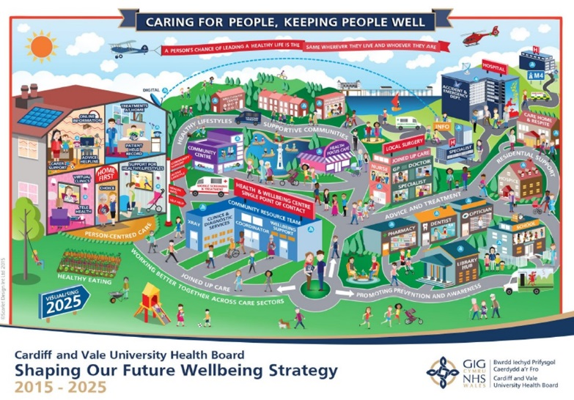
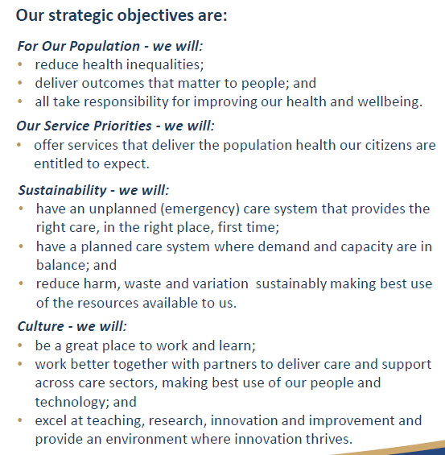
Organisational Objectives
Every one of us contributes to the outcomes of the overall organisation. It is important you understand how your personal objectives support the organisation to reach its goals.
To help us give the best possible care and services, whatever our role, it is important that we understand what is expected of us, how our contribution helps the organisation achieve its aims and that we are rewarded for doing the right things well.

Slide 20
Setting Future Objectives
Checklist for objectives – do you know…..
What is expected
What it will look like if it is complete
When it should be complete
what the end results should be
if you have the skills to do it well
how you will know if you have done it well

Slide 21
Setting Future Objectives

Slide 22
Development and Training
When you consider what it will take to allow you to meet your new objectives, you can gain support, learning and development in a number of ways;
  70% job-related experiences
  20% interactions with others
  10% formal educational events
When you have considered what support you need to meet your objectives you can start to complete the Development Action Plan which will record the support, learning and development you need to be able to do your job well. Each development opportunity should be clearly linked with a specific objective.

Slide 23
Recording on ESR
There are some core pieces of information that your manager must record on ESR.
Date of your Appraisal
Placement of the Career Conversation Matrix
Development Action Plan
Pay progression

Slide 24
PADR Principles
We will agree and understand what's expected of us in terms of what we should be doing and how we should be doing it
We will all receive constructive and timely feedback on how we have done
We will all ensure that we actively seek to develop and improve what we are doing for the benefit of patients
Doing the right things – Doing them the right way
Doing things better
Notes:
TIME FOR SLIDE: 2 minutes
These are the PADR principles and these remain the same – this hasn’t changed. What has changed is the way we carry out the conversation and the information that is recorded.

Slide 25
Pay Progression
Pay Progression policy applies to all members of staff on NHS Terms and Conditions of Service and works closely with the Appraisal Process.
There are five specific pay progression standards which set out requirements which need to be demonstrated before you are able to progress to your next pay step point on your pay step date. These standards are:
  The appraisal process has been completed within the last 12 months and outcomes are in line with the organisation’s standards.
  There is no formal capability process in place.
  There is no formal disciplinary sanction live on your record.
  Statutory and/or mandatory training has been completed.
  For line managers only – appraisals have been competed for all your staff as required.
Your pay step submissions will only take place after two, three or five years depending on your pay band. Your appraisals will continue to take place annually.
Notes:
TIME FOR SLIDE: 5 minutes
These are the rules from the All Wales Pay Progression policy. It has been revised and from ????? Your staff will not automatically get Pay Progression, you will have to go on to ESR and record that you are happy for them to receive it or they will not.

Slide 26
Pay Progression Policy
This Pay Progression Policy does not replace or change Appraisal policies but does set out three principles that will be embedded into local appraisal processes. They are:
  We will agree and understand what’s expected of us in terms of what we should be doing and how we should be doing it
  We will all receive constructive and timely feedback on how we have done
  We will all ensure that we actively seek to develop and improve what we are doing for the benefit of patients

Slide 27
Summary

