Slide 1

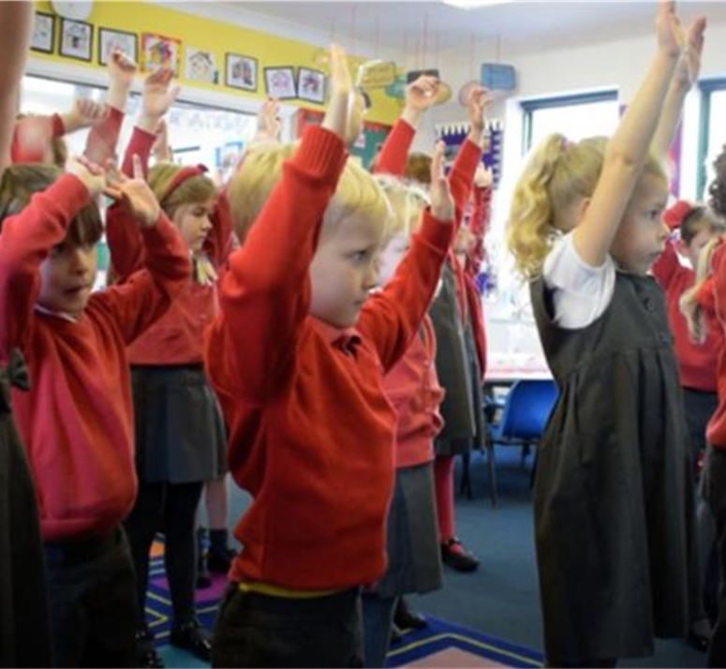
What Surrounds us, Shapes us: A Whole System Approach to Preventing Obesity and Type Diabetes
Director of Public Health Report 2025
Claire Beynon
Executive Director of Public Health

Slide 2
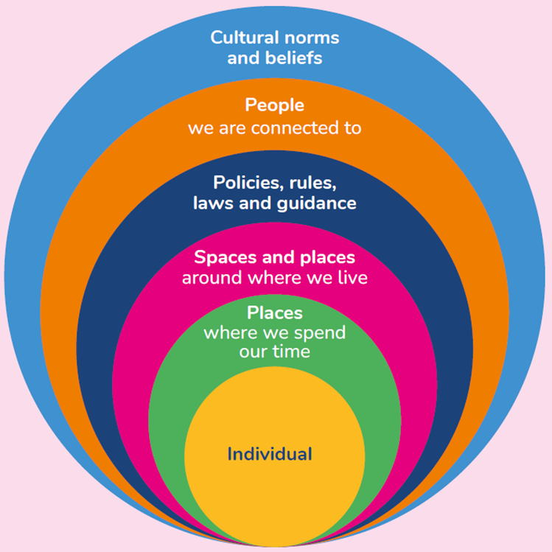
Introduction
Director of Public Health Report 2025 – independent and objective review by the Executive Director of Public Health
This year’s report looks at the prevention of both obesity and type 2 diabetes
It looks at what influences how we live and how the world has changed over time
It is a complex issue that needs an evidence-based solution
It outlines what we are already doing to combat this
Finally, there are three calls to action that we can all work on together
Notes:
The places where we spend our time. These can all influence how we access and experience food and movement through how they are designed, built and how they operate. Places could include our schools, workplaces, hospitals, health centres, sports clubs, community centres as well as places of worship.
Around the places where we spend our time are the spaces and places around where we live like our neighbourhoods, high streets, parks, fields, playgrounds, roads, and public transport routes. These can all affect how we access food and experience movement through how they are designed.
Next are the policies, rules, laws and guidance that shape our places and spaces. These can all affect what food is available, affordable and promoted, as well as what opportunities to move are made possible.
Then we have, the people we are connected to like family, friends, colleagues and neighbours. They can affect how we think, feel and act about food and movement. Our connections to other social support networks, either in person or virtually are often around common interests or at life stages and these can also shape what we think, feel and how we act.
Finally, cultural norms and beliefs. These are the shared ideas and unwritten rules that shape can how people live, what they value, how they think and what they prioritise.

Slide 3
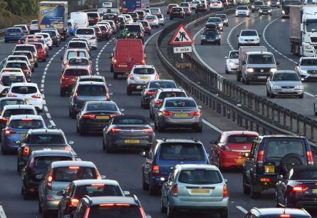
What surrounds us, shapes us: what has changed over time?
Places where we spend our time, such as schools and workplaces has evolved
Places and spaces where we live, such as roads, transportation and food environment have changed hugely
Policies, rules, laws and guidance have had some positive influence; however, keeping pace with societal changes and industry lobbying is a challenge
Cultural norms and beliefs about how we usually behave has changed over time, and shapes how we live

Slide 4
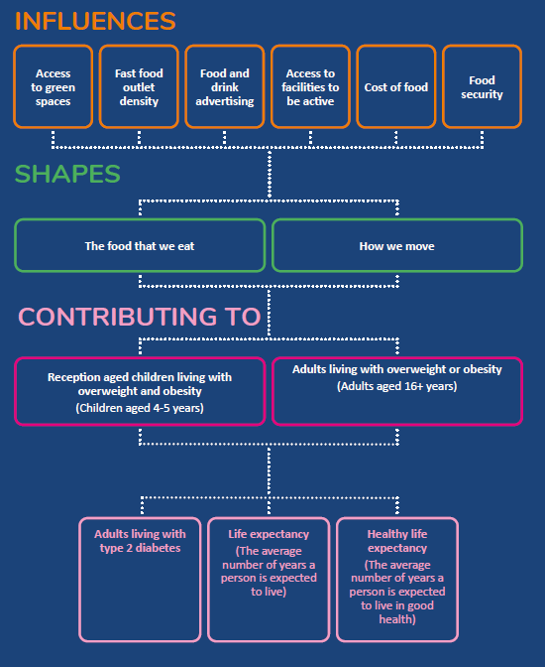
The data story
1 in 10 children starting school in Cardiff and Vale of Glamorgan are obese
Children and young people living with obesity are 5 times more likely to be living with obesity as adults
Obesity leads to many health problems, including type 2 diabetes and cardiovascular disease and this can affect life expectancy and healthy life expectancy
1 in 15 people aged 17 and over in Cardiff and Vale of Glamorgan are already diagnosed with type 2 diabetes – this is set to increase to 1 in 11 adults (in Wales) by 2035.
Importantly this is preventable
Notes:
There are numerous key influences that act on our day-today lives for example having access to green space and having food security that shapes the food that we eat and how we move.
This then contributes to obesity and overweight in children and adults, which is measurable
Already 1 in 10 children starting school in Cardiff and Vale of Glamorgan are obese
Obesity leads to many health problems, including type 2 diabetes and cardiovascular disease and this can affect life expectancy and healthy life expectancy
Importantly this is preventable

Slide 5
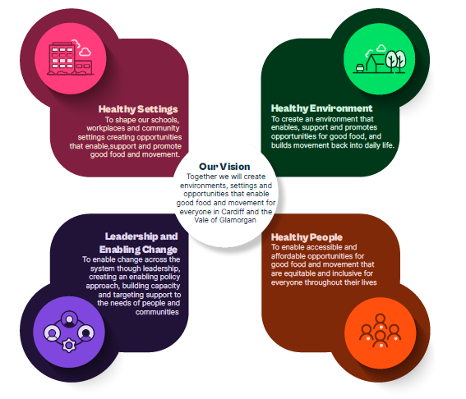
What are we doing already?
Healthier advertising and sponsorship policies developed by Vale of Glamorgan Council and Cardiff Council
Significant progress in transforming active travel infrastructure
Active soles campaign implemented across Cardiff and Vale UHB, Cardiff Council, Vale of Glamorgan Council and Cardiff Metropolitan University
Food Cardiff have rolled out the Planet Card, supporting low-income families to access healthy food
Food Vale have developed the Llantwit Major Food Access Partnership Project, tackling food insecurity in the area
Notes:
Need to look at what surrounds us, and not scaling up individual behaviour change. Individual level action won’t have the population level impact we need.

Slide 6
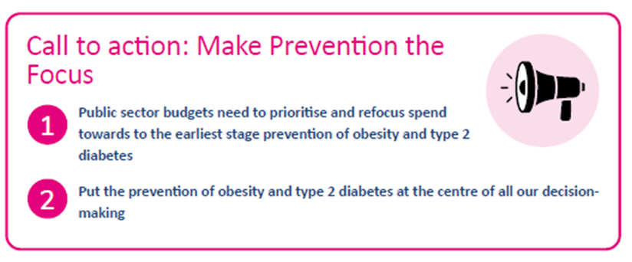
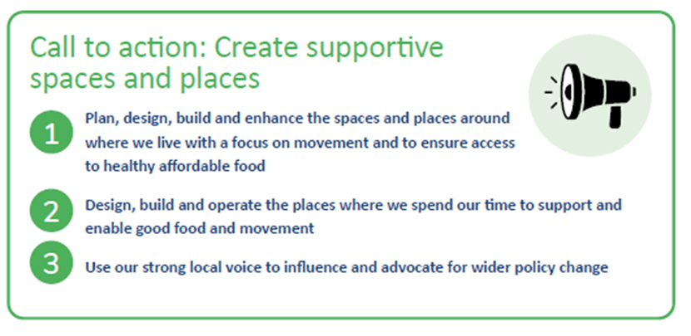
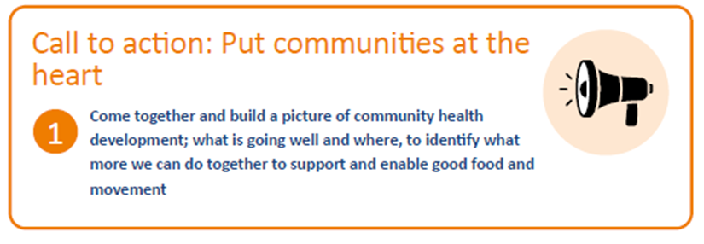
Three calls to Action:

