Slide 1
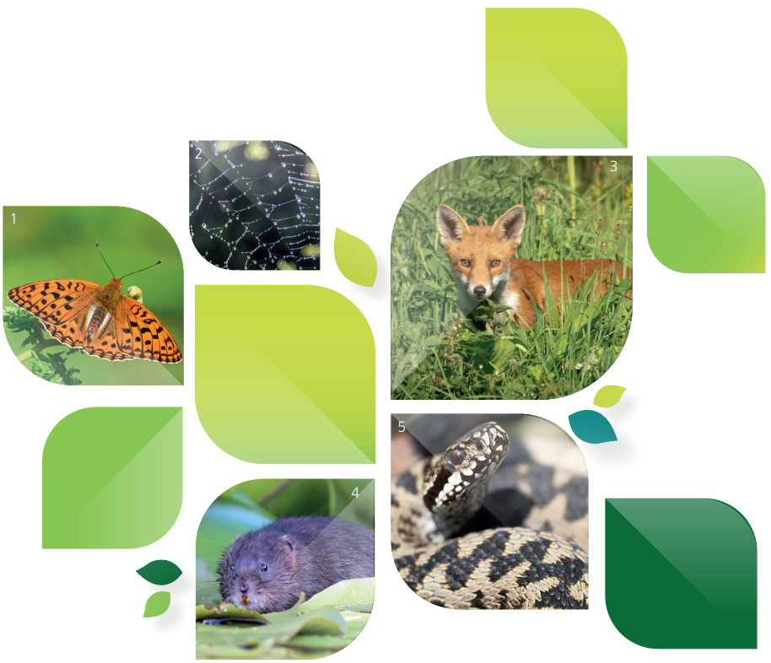

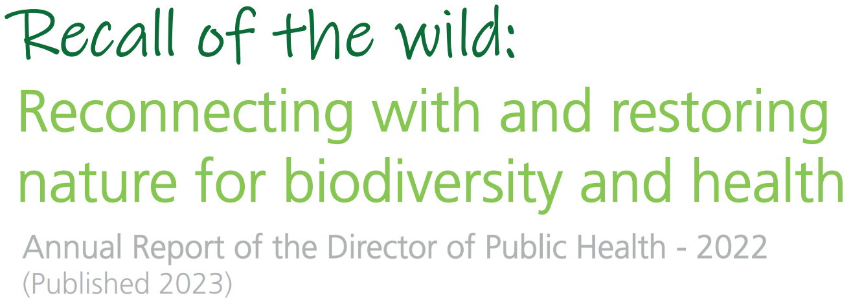
Board 30th November 2023

Slide 2
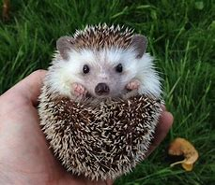
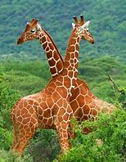
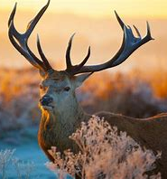
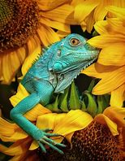
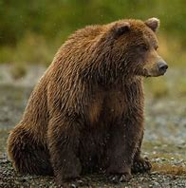
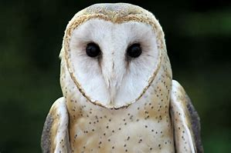
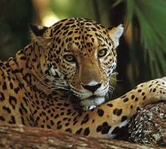
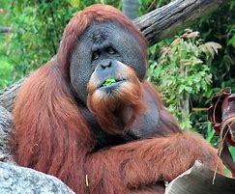
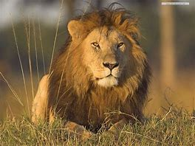
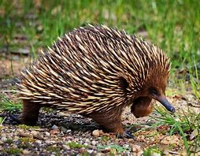
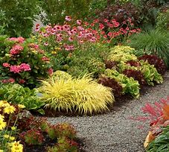
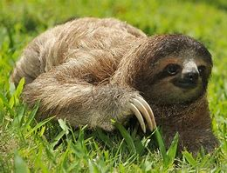
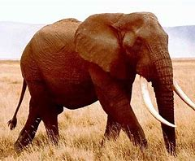
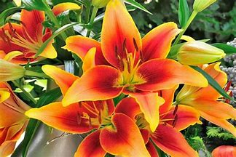
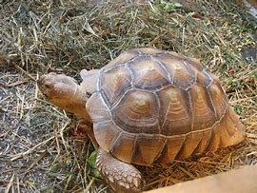
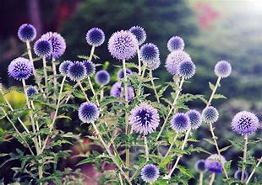
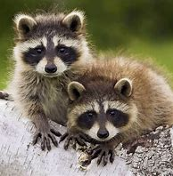
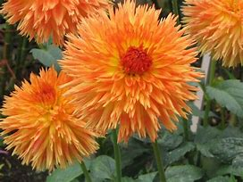
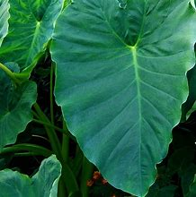
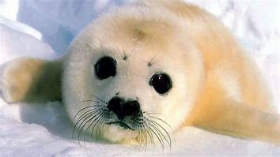
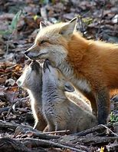
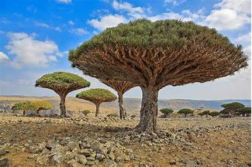
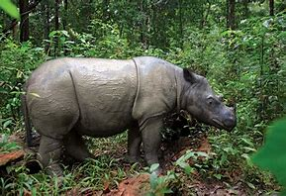
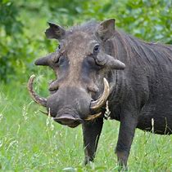
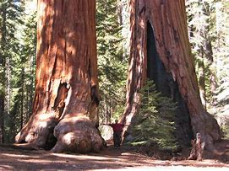
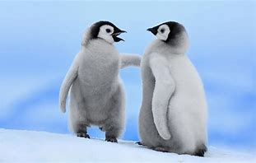
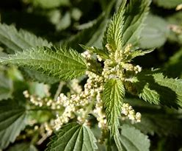
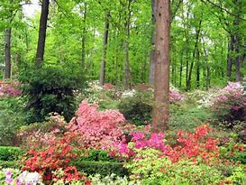
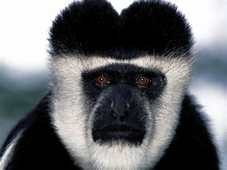
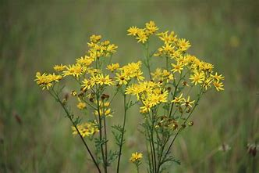
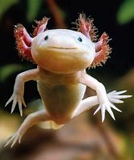
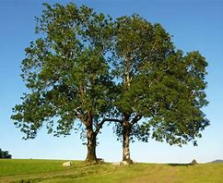
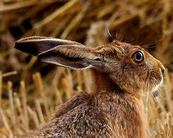
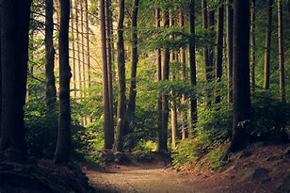
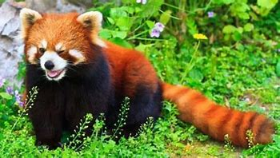
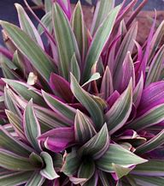
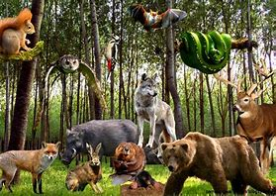
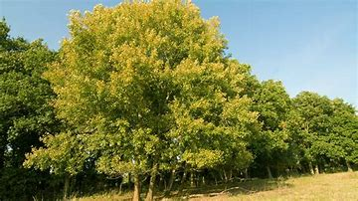
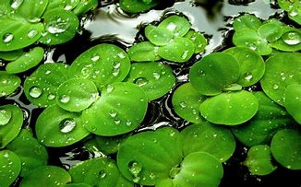
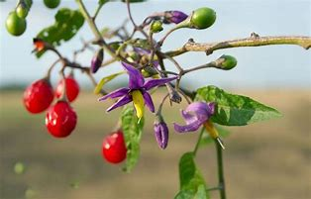
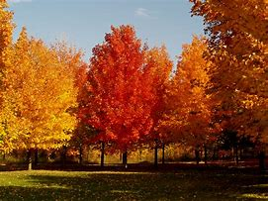
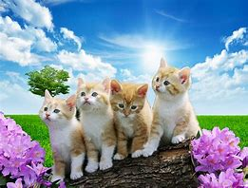
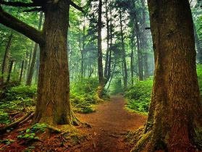
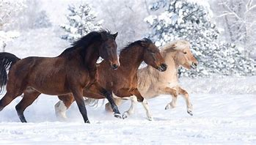
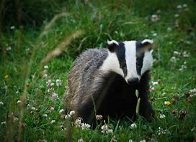
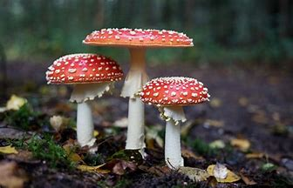
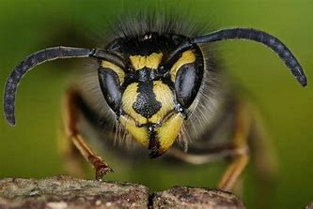
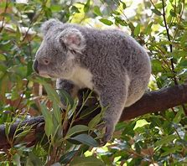




















































The Nature Emergency
Nature and Health
Reconnecting with nature
Restoring
nature
Recommendations
Board request

Slide 3









The Nature Emergency
Nature and Health
Reconnecting with nature
Restoring
nature
Recommendations
Board request

Slide 4

The Nature Emergency
Nature and Health
Reconnecting with nature
Restoring
nature
Recommendations
Board request

Slide 5








The Nature Emergency
Physical activity
Climate change
Nature and Health
Food provision
Microbiome
Reconnecting with nature
Social interaction
Pharmaceutical opportunities
Restoring
nature
Relaxing and calming
Clean air
Recommendations
Board request

Slide 6





The Nature Emergency
Nature and Health
Reconnecting with nature
Restoring
nature
Recommendations
Board request

Slide 7


The Nature Emergency
Nature and Health
Reconnecting with nature
Restoring
nature
Recommendations
Board request
Proportion of UK population living in urban and rural areas, 1950-2050. Data source: Copyright © 2018 by United Nations, made available under a Creative Commons license CC BY 3.0 IGO: http://creativecommons.org/licenses/by/3.0/igo/ Available at: United Nations World Urbanisation Prospects 2018. Note: proportions are estimates to 2018, followed by projections.
Percentage of households in proximity to accessible natural green space (2017). Adapted from OS data from InfoBaseCymru on the Physical environment indicators of WIMD, using QGIS

Slide 8




The Nature Emergency
Nature and Health
Reconnecting with nature
Restoring
nature
Recommendations
Board request

Slide 9




The Nature Emergency
Nature and Health
Reconnecting with nature
Restoring
nature
Recommendations
Board request

Slide 10


The Nature Emergency
Nature and Health
Reconnecting with nature
Restoring
nature
Recommendations
Board request

Slide 11


Senior Leadership Board is requested to:
Approve the report.
Support the recommendations, including the plan to review recommendations specific to the UHB for inclusion in the Acting for the Future strategic programme.
The Nature Emergency
Nature and Health
Reconnecting with nature
Restoring
nature
Recommendations
Board request

Slide 12

Thank you for listening
Any questions?

Slide 13
References
University of Derby. Biodiversity Stripes, based off data from Living Planet Index database 2022 {Online]. Available at: #BiodiversityStripes
State of nature partnership. 2019. State of Nature: A summary for Wales. Available at: State-of-Nature-2019-Wales-summary.pdf (nbn.org.uk)
State of nature partnership. 2023. State of Nature: A summary for Wales. Available at: TP26053-SoN-Wales-summary-report-v10.pdf.pagespeed.ce.UcI3aoHAY6.pdf (stateofnature.org.uk)
Mathews F. Et al. 2020. The State of Mammals in Wales: A report by the Mammal Society for Natural Resources Wales, produced in association with Wales Mammal Biodiversity Action Forum. The Mammal Society, London. ISBN: 978-0-9935673-6-0. Available at: https://www.mammal.org.uk/science-research/the-state-of-mammals-in-wales-cyflwrmamaliaid-yng-nghymru/
Natural Resources Wales. 2020. Tree cover in Wales’ towns and cities: update 2020. Available at: Tree Cover in Wales' Towns and Cities (summary report) (naturalresources.wales)
Intergovernmental Science-Policy Platform on Biodiversity and Ecosystem Services (IPBES). 2019. Global assessment report of the Intergovernmental Science-Policy Platform on Biodiversity and Ecosystem Services. Brondízio, E.S., Settele, J., Díaz, S., Ngo, H.T. (eds). IPBES secretariat, Bonn, Germany. 1144 pages. ISBN: 978-3-947851-20-1.
Natural Resources Wales. Welsh Information for Nature-based Solutions (WINS) online tool, accessed 31 November 2023, available at: Welsh Information for Nature-based Solutions (WINS) (arcgis.com)

