Slide 1

Commissioning Intentions 2022-2025 and IMTP Process Update
Appendix A
Jonathan Watts, Head of Strategic Planning

Slide 2
What’s the point of an IMTP?
Background
Current context
The 22-23 WG Planning framework is still to be published- ministerial letter gives solid pointers but the framework will give more detail.
Document <50 pages still the expectation
The UHB already has an approved plan from 19-20 and an ‘approvable’ plan for 20-21. We should be looking to build upon these but reflect the new challenges and opportunities which have subsequently emerged.
Set organisational direction
Identify priorities
Provide assurance on delivery
Align performance, finance, workforce and wider corporate teams
Act as ‘the one plan’ for the UHB
A statutory requirement
The output we need to produce and by when
The more ‘traditional’ three year IMTP ready for Board approved by 31st January 2022 which takes a three year outlook in terms of;
Year 1: In detail, firm actions
Year 2: Outline actions and approach
Year 3: Indicative approach and focus
Indications are that the plan will not need to be submitted to Welsh Government in mid February.

Slide 3
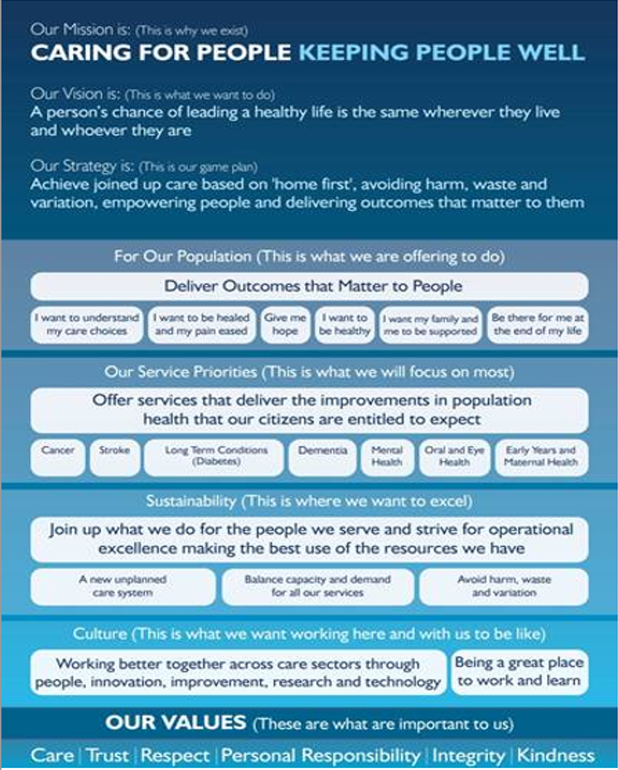
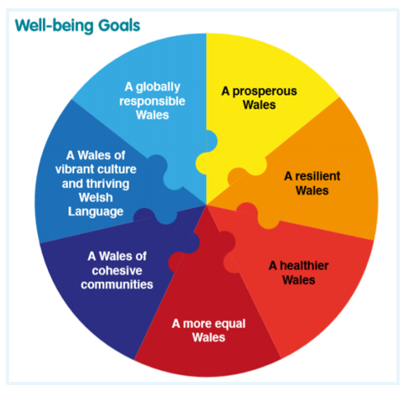

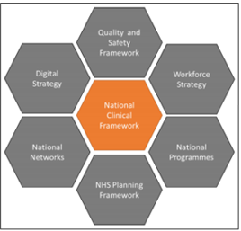
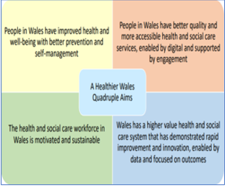
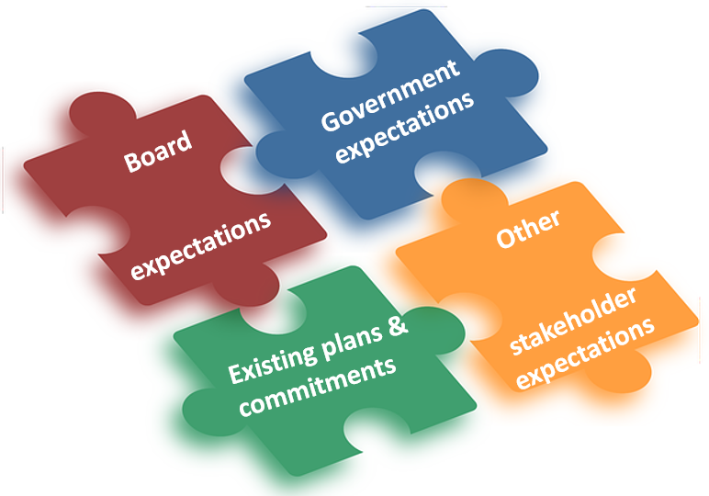
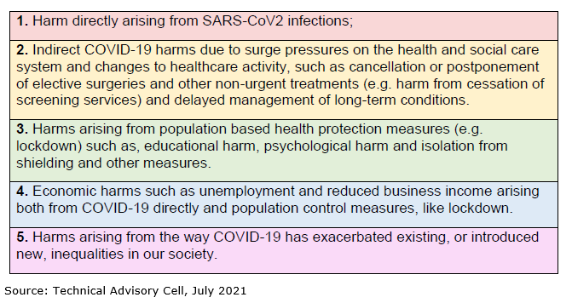
A Recap
We aren’t starting from scratch. Range of existing strategies, policies, frameworks, programmes , priorities across the system
Most are complimentary- they did not represent conflicting directions of travel. However the challenge is to find a way in the approach and language of our plan which meets the needs and requirements of all interested parties.
Ministers priorities: click here

Slide 4
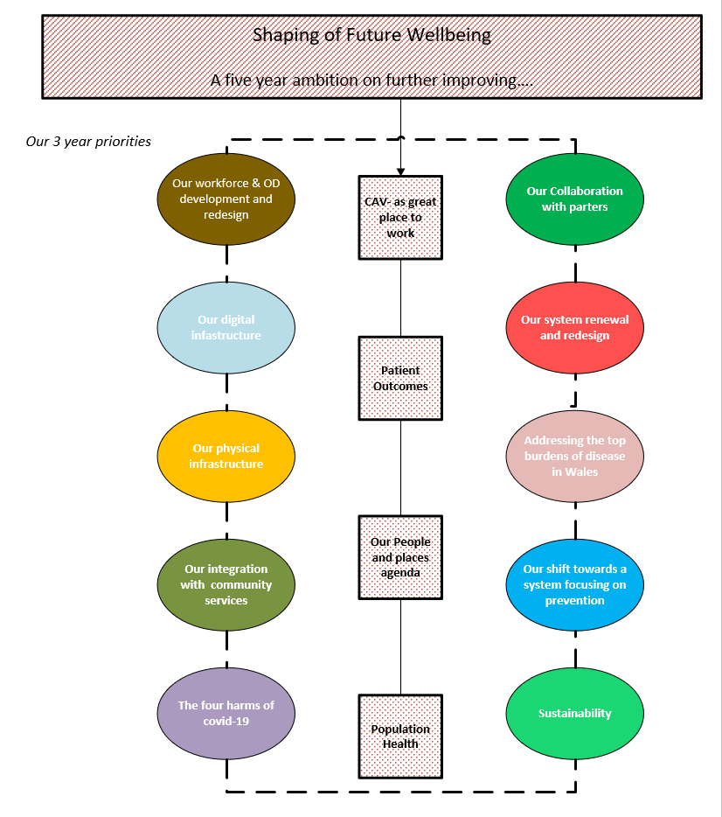


What we have decided / agreed to date
Ten priorities that are going to require progression over the life of this plan.
The focus of the 22-23 plan should on four objectives in order to keep eyes on successful delivery of SOFW
The critical deliverables that need to be realised during the life of this plan. These critical deliverables can all be found by clicking here.

Slide 5




So what’s the plan going to look like
Response
Ongoing Covid response inc;
  modelling and assumptions used
  Plan for maintaining essential services
Ongoing Vaccination programme
Recovery
Portfolio programmes
Workforce &OD plan inc the WOD programme
Financial plan
Digital inc the Digital Programme
Quality & Patient Safety statements
Shaping our Future population Health Programme
Effective commissioning
  WHSCC
  EASC
Strategic Portfolio
  SOCs inc tertiary services programme
  @Home inc Cluster planning
  Shaping our future Hospitals
  Other strategic transformation initiatives
    HASU / thrombectomy
    Critical care
    BMT / Haematology / AOS
    Stroke & thrombectomy
    Regional working inc Eye services, AOS, Orthopaedics
Plan accompanied by the minimum data set (MDS)
Sets out the core business of the UHB. A suite of data @ specialty/department level split by calendar month for
Demand/capacity
Workforce
Finance
Operations to sense check and confirm their core/bottom line position for demand/capacity
Workforce and finance to confirm respective.

Slide 6
Ensuring our plan is a deliverable plan-
Prioritisation principles: A service development choices framework
Attractiveness
Risk & Achievability
Evidences Patient safety, quality and/or compliance issues – Health & safety, national accreditation, IPC etc and/or
Affordability
Evidence that reoccurring revenue has been secured and/or high degree of confidence that revenue will be secured and/or
Evidences a direct link to one or more of the UHBs 10 priorities and/or
Evidence that benefits, measures, critical path for delivery of these benefits are clearly understood and demonstrate that desired outcomes are achievable.
Evidences a direct link to delivery of one or more operational objectives e.g. a ‘target’ and/or
Evidenced as a critical enabler for other agreed service developments to be able to progress as planned and/or
Represents an area of political interest.
Evidenced as having a direct impact on effectiveness of the UHBs infrastructure (digital, equipment, estate) and/or
Evidence that poor benchmarking indicators with other providers will be directly improved and/or
Scheme is evidenced as revenue generating and/or
Evidence of ‘spend to save’ and/or
Evidence that necessary capital has been secured and/or high degree of confidence that revenue will be secured and/or
Evidence that the scheme is cost neutral
Evidences direct contribution to improving population health and/or
Whilst the critical deliverables for year one of the plan have been identified a small number are likely not yet to be fully resourced (revenue, capital or both).
A set of principles have consequently been developed against which these service developments can be measured against an other(s) to understand their relative priority / immediate criticality in order to ensure any available resources are put into the most appropriate areas.

Slide 7
Timeline and key milestones
12 Oct
Local Planning framework issued
27 Jan
Approval of plan by Board
08 Mar
09 Nov
17 Jan
11 Jan
16 Nov
16 Dec
01 Dec
23 Nov
29 Nov
01 Dec
WHSCC 22-23 commissioning intentions finalised at Joint Committee
Testing of (i) approach to prioritisation (ii) proposed plan architecture with Strategy and Delivery Committee
Return of completed plans from Clinical Boards
Update on plan development to CHC planning committee
Update on plan development with the Local Partnership Forum
Prioritisation exercise by SDDG
Outcome of prioritisation exercise shared with Management Executives
Draft plan to Strategy and Delivery Committee
Deadline for IMTP to be finalised
CHC Planning committee to receive IMTP
01 Jan
Deadline for required contributions to plan
Points to note:
(i) Bespoke CHC touchpoint to be arranged in light of service
planning committee dates
(ii) Ambulance Commissioning intensions still unconfirmed
(iii) Awaiting formal publication of the NHS Planning Framework

Slide 8
2022-23 Ministerial Priorities
Covid-19 Response
Continued progress on vaccinations, from second doses to booster and flu arrangements;
NHS influence and data feeding into government choices and actions;
Continuing to contribute and discharge an effective Wales TTP system;
Responding to expectations for long covid, whilst we continue to learn about the diagnosis and treatment;
Ongoing safe environments for patients and staff in healthcare settings –recognising this changes based on local community prevalence;
An understanding of broader harms and showing how the NHS is building these into plans.
NHS Recovery
There needs to be a clear plan for waiting lists and times–progress within the gift of health organisations from core allocations, as well as clarity on what proposals need national/ Welsh Government support whether for service models or facilities.
This is an opportunity to do different things. The Minister is committed to ensure that we do radical things, be innovative and show we are transforming the system from this difficult experience.
To work on service change options early, showing better access and outcomes for patients..
Continuing to address NHS pressures, dealing with high volumes of patients and a return of services, whilst continuing to operate safely in a Covid environment and maintaining operational readiness if required to respond to further waves.
Resilience in planning and contingency planning for future threats and demands. Examples include new variants and winter pressures
Collaboration with other NHS organisations to progress appropriate regional solutions in earnest.
Working alongside social care
Building upon relationships with Regional Partnership Boards to plan and deliver effective integrated services in response to population need.
Understanding any fragilities in the local social care and care home sector and working with partners to identify any contingencies which may be required.
Continuing to engage in discussions about the recovery and future of social care following the consultation on the white paper Rebalancing Care and Support;
A Healthier Wales
This provides permissions and a clear mandate for the NHS to use existing actions contained in the Workforce Strategy and the National Clinical Framework to make rapid progress.
Local implementation of quality statements and the new Quality and Safety Framework (when published).
A relentless focus on improving health outcomes and reducing inequalities (see priority 8 below);
The opportunity to develop more appropriate system and clinical measures that track towards A Healthier Wales

Slide 9
2022-23 Ministerial Priorities
NHS finance and managing within resources
Clarity of financial planning for this year and more importantly, for subsequent years, including clarity on longer term assumptions for sustainable services and workforce planning. This will be particularly important as we reactivate the statutory requirement for 3-year, financially balanced IMTPs.
Tracking financial performance at national and organisational level.
A desire to see use of NHS funding and resources to support cross-government priorities which have an impact on the wider determinants of health.
Application of prudent health care and value based healthcare to services and at system level.
Mental health and emotional well-being:
Raising expectations for change away from traditional and institutionally based services. This includes evidence of shifting services away from a medical model.
Focusing on models that meet the needs of children and young people
Workforce well-being and welfare, with an emphasis on staff support and resilience. How we care for our own staff further to the pandemic experience will be a reflection of how we wish to support the wider population
Supporting the health and care workforce:
Robust workforce planning, informed by demand projections and service planning
Continuing to recognise staff efforts.
Engaging the workforce, as well as wider stakeholders, in service change and transformation.
Encouraging local innovation and implementation of national programmes.
Population health, notably through the lens of pandemic experience and health inequity:
Short-term decisions must be made in the context of making a future difference to our population health
The specific needs and impacts upon deprived populations, those with co-morbidities or learning disabilities, vulnerable groups and Black, Asian and Minority Ethnic communities must be understood and grounded in lived experiences.
Evidencing a shift to prevention and wellness.

Slide 10
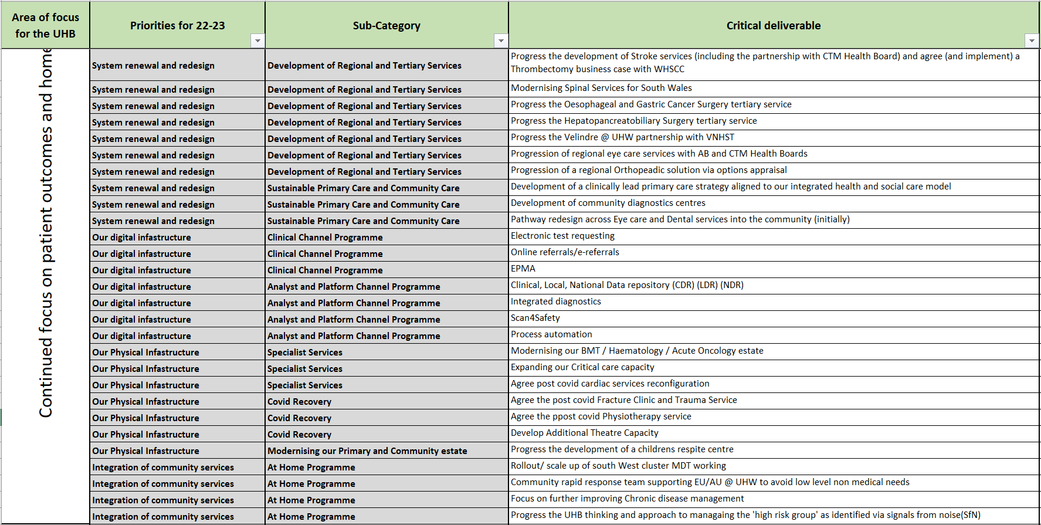
2022-23 Critical Deliverables

Slide 11
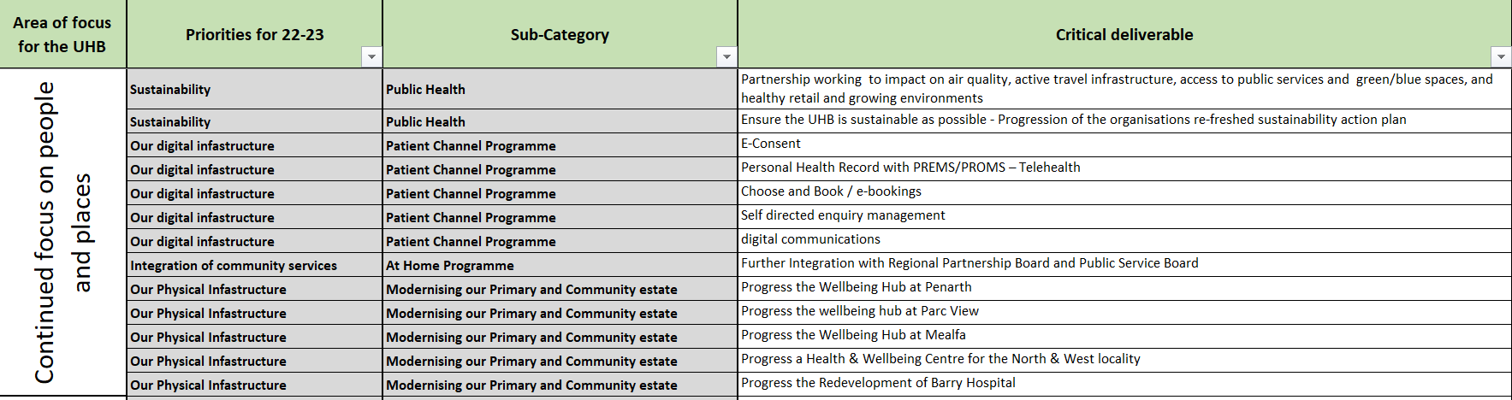
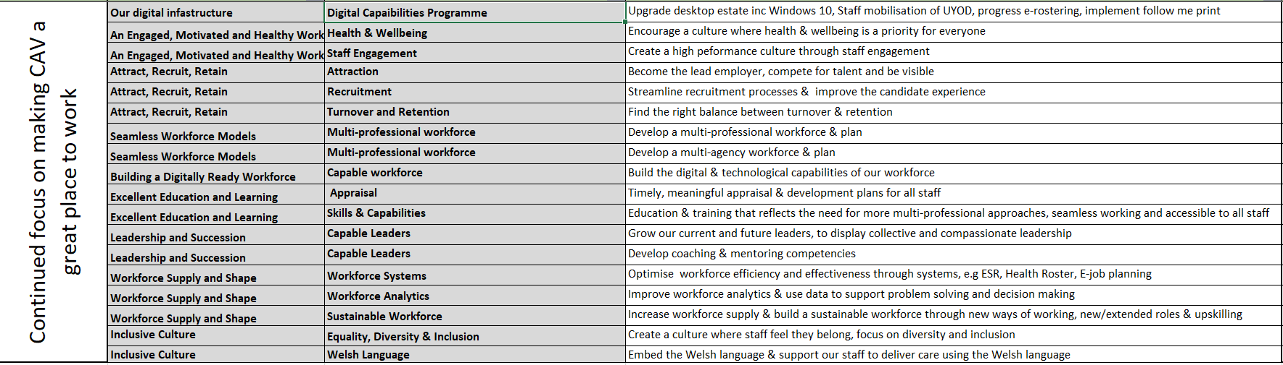

Slide 12
