Slide 1
Strategy Refresh
September 2023

Slide 2

Our Refreshed Strategy
We would like to thank everyone who have helped us develop this strategy by participating in the many engagement events we held and providing feedback via the surveys.
We have listened to what you have told us is important to you and hope that you see this reflected in this refreshed strategy.

Slide 3
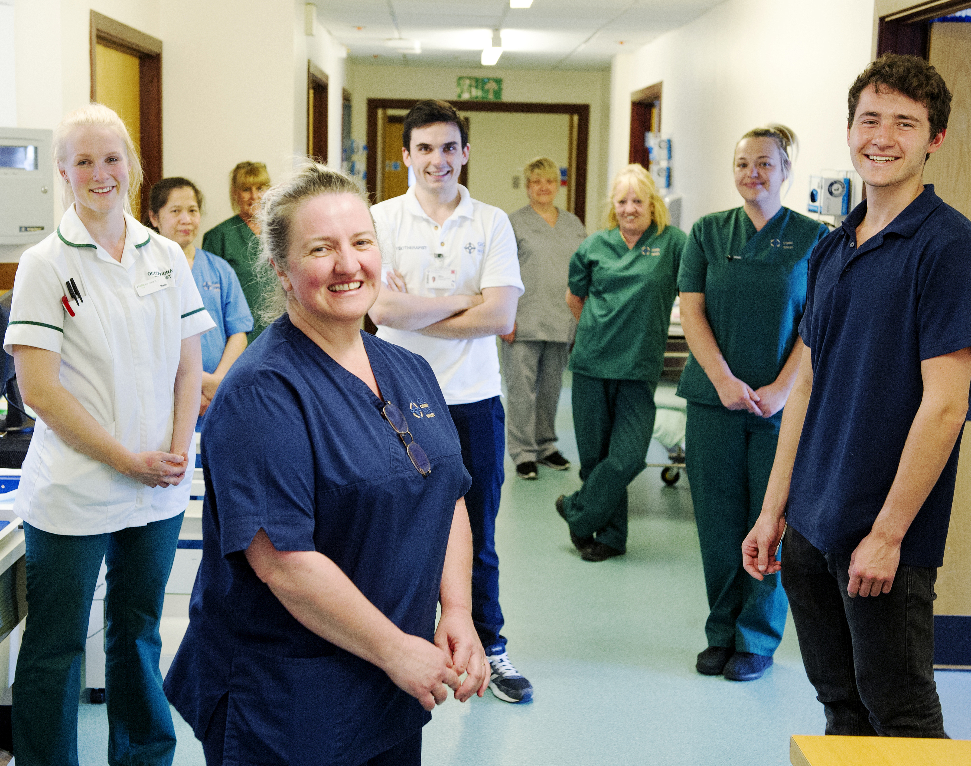
Our Vision
Working together, we will help improve lives so that by 2035, people are healthier and unfair differences in health outcomes are reduced.
The care we provide for people who need our services and those delivering services will be outstanding, with outcomes and experience for all that compare with the highest performing peer organisations

Slide 4




Our Strategic Objectives:
Key goals for delivering our 10 year strategy

Slide 5
Putting People First
We will be a great place to train, work and live, where we listen to and empower people to live healthy lives.
By 2035, colleagues would recommend us a great place to work, our workforce will reflect the diversity of our communities and more people will be living healthier lives.

Slide 6
Priorities
People will feel valued, developed, supported and engaged.
We will have an inclusive culture where the diversity of the Health Board’s people will be representative of the Health Board’s local populations.
Through our integrated population health improvement programme, we will enable and empower people to live healthy lives and reduce their risk of ill health.

Slide 7
Providing Outstanding Quality
We will provide outstanding services which are equitable, timely and safe, where people are treated with kindness and are supported to achieve the outcomes that matter to them.
We will have reduced inequities in prevention, improved access to clinical services and clinical outcomes.

Slide 8
Priorities
Focus on minimising inequity in healthy behaviours, preventative services, access to clinical services, and health outcomes, to reduce current unfair, unjust differences experienced by people in the community.
Deliver outstanding quality of care every time - from the most complex care for the most critically ill to routine care that prevents and protects against ill health and disease – addressing physical and mental health needs. Achieve the best outcomes for patients in line with what matters most to them, their families and carers.
Develop the Health Board's approach to continuous quality to improvement and make the best use of the Health Board’s resources.

Slide 9
Delivering in the Right Places
By 2035 we will be using real time integrated data to inform joint decision making and multi-disciplinary team working, giving people access to and ownership of their data to enable them to manage their health and wellbeing.
We will be well on our journey to provide care in the right place, in facilities that are fit for purpose, flexible and promote recovery.

Slide 10
Priorities
To achieve digital maturity enabling the Health Board to connect and communicate, supporting shared decision making in the planning and delivery of health care services.
Refresh and deliver the Health Board’s programme for creating integrated health and care facilities in our local communities where people can access the information and support they need under one roof.
With Cardiff University and NHS partners, develop the Health Board’s plans for ensuring hospitals providing acute care are fit for the future.
Develop more shared infrastructure with public and private sector partners to get best value for the Health Board’s investment.

Slide 11
Acting for the Future
We will work to ensure that what we do today does not compromise the wellbeing of our future generations. We will protect the environment and develop and use new technologies, treatments and techniques to provide the best possible health outcomes and sustainable health care into the future.
By 2030 we will have reduced the Health Board’s carbon footprint by 34% and will have increased our research and clinical innovation activities.

Slide 12
Priorities
Develop and expand the Health Board’s research, teaching and innovation portfolios in collaboration with Cardiff University and other partners.
Contribute to the development of and adopt cutting-edge and novel treatment, techniques and technologies where they deliver improved patient outcomes and improved value.
Maximise the Health Board's contribution to the foundational economy.
Deliver the Health Board's carbon emissions targets and fully support active and sustainable travel for staff and visitors to patients. Promote, reward and embed successful waste reduction as part of our quality programme of continuous improvement.

Slide 13

shapingourfuturewellbeing.com

