Slide 1

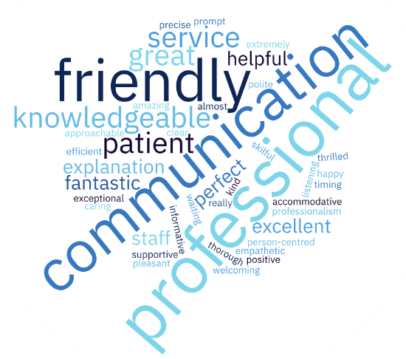
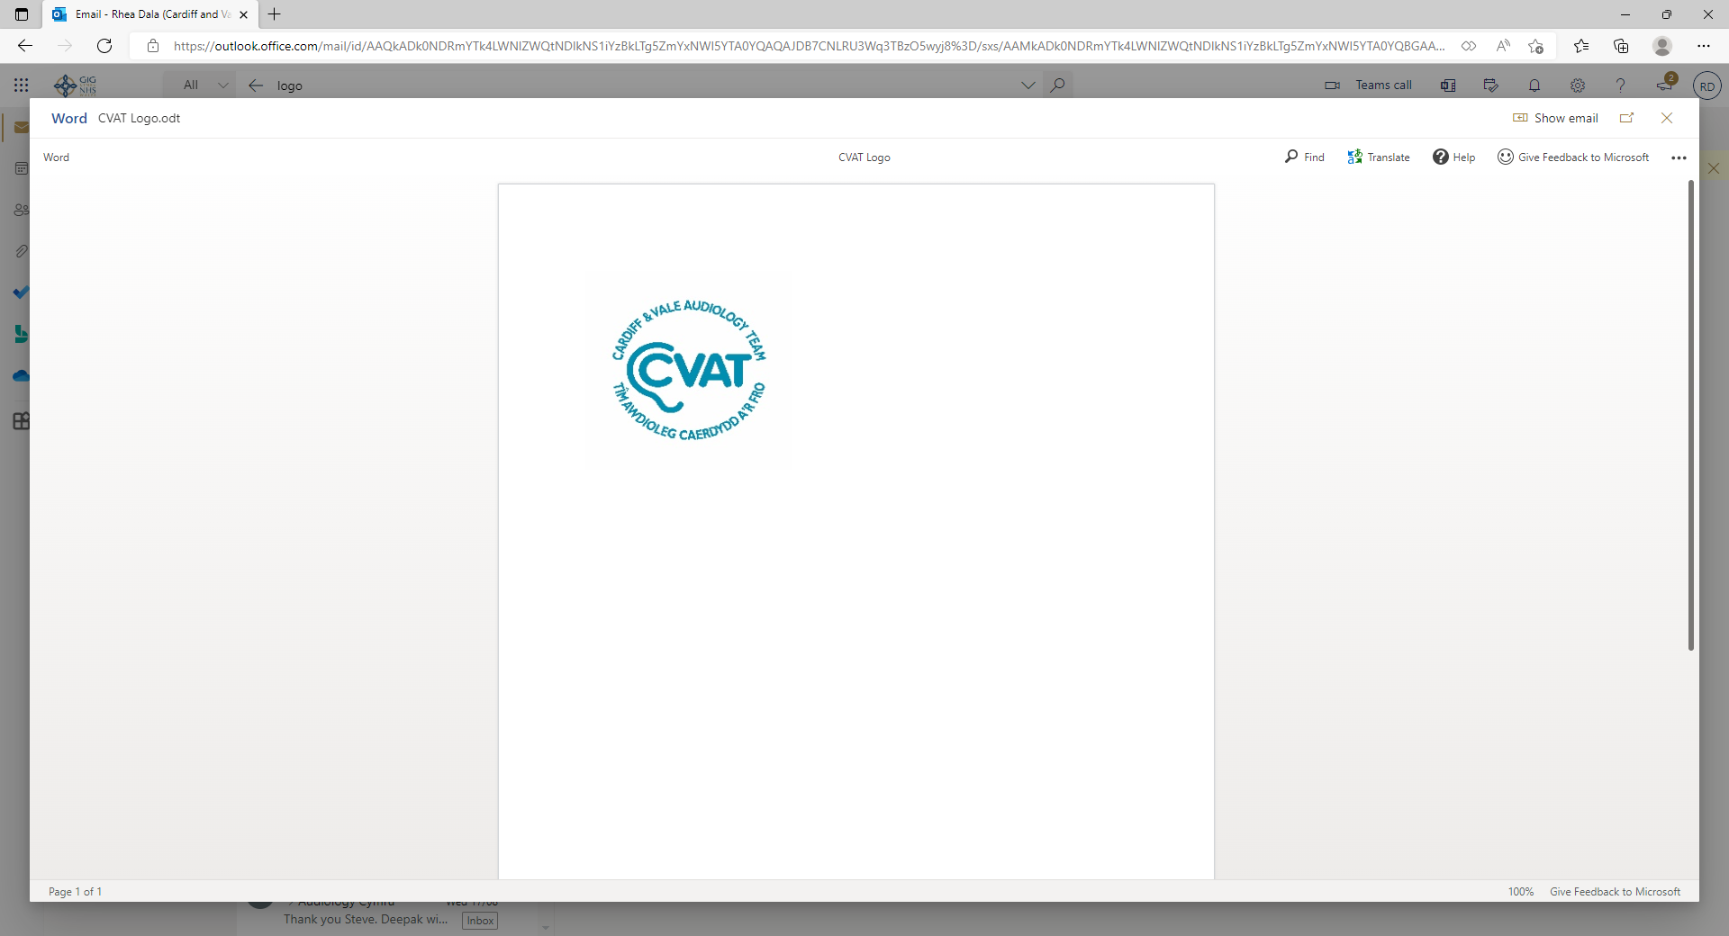
Adult Audiology Services
Service User Feedback 2025
Satisfaction questionnaires were given out to every Adult Audiology Service users in Cardiff and the Vale of Glamorgan from August 2024. We received 188 responses, and the results are shown below.
OVERALL
We were very pleased to learn that overall responses for the department were very postitive, with 95% of patients very satisfied with their appointments.
“Excellent service, we arrived a few minutes early but were then called. Audiologist extremely good and very professional. Here with my mum who was thrilled with the service and care shown”
“Hannah was kind, efficient, she listened. As a retired nurse what more could I ask from an NHS member of staff? Thank you.”
REPAIRS
Service users were very satisfied with the service provision for open access and postal repairs.
“The helpfulness of Louise in the drop-in clinic. Very patient and willing to answer all my questions.”
“Open access and free. Pleasant professional staff - what is not to like?”
“Rebecca was very helpful and skilfully repaired both of my hearing aids. She explained what was wrong and fixed them both.”
STAFF CARE & TREATMENT
An extremely high level of satisfaction was reported with
The professionalism of staff
The opportunities to discuss, and help offered with difficulties in appointments
The time waiting to be called into the appointment.
The below word cloud highlights the diversity of the complements received.
ACCESSIBILITY
The responses were very positive regarding:
Communication with the department
Waiting time for their appointment
Support with communication needs.
SURROUNDINGS
There was a high level of satisfaction the welcome received at reception and the appearance and comfort of rooms. However, 10% of patients reported at least dissatisfaction with the temperature in the clinic rooms and/or waiting areas. The only other consistent area of dissatisfaction was with parking availability.
Our Response:
We recognise our service users dissatisfaction and we are constantly working to improve the surroundings of our departments.
INFORMATION
Satisfaction levels were high with the department’s
Delivery of information prior to, at and following appointments
Information available on the website.
Service users were very satisfied in the way information was delivered and their involvement in the decision making about their care.
“Audiologist was very friendly and helped explain hearing loss in a way I could easily understand”
All negative comments are taken seriously and will form part of next year’s action plan for service improvement.

