Slide 1
Digital and data

Slide 2
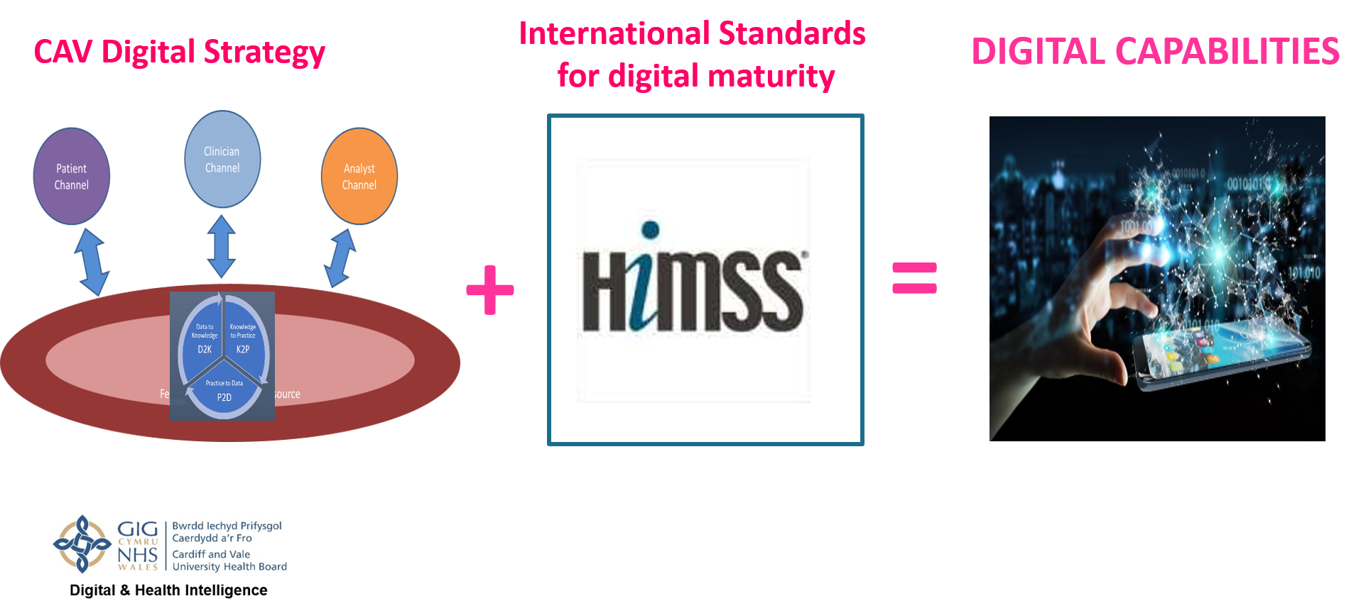
Digital - a learning health and care system

Slide 3
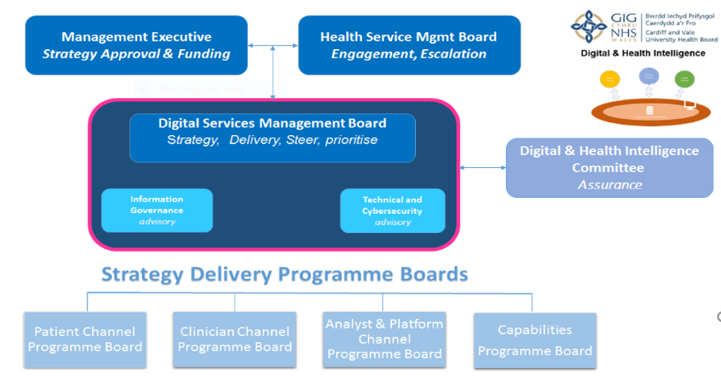
Performance highlights 2020 - 2021
Strategic developments
Digital strategy approved by CAV UHB Board in July 2021
  CAV committed to becoming a Learning Health and Care System
Governance structure established – clinically led & chaired by clinicians
  Delivery roadmap produced - what we need to do in the next few years
Grant Thornton praise our digital strategy as part of UHW2 business case planning
Operational – some highlights
Data
Mobilisation
Virtual - secondary care
Major initiatives
Innovation
Approved business cases
Show location of suspected & confirmed Covid-19 patients in near real time across all sites
Show patients indicating 14+ days since testing, important to inform anticipated flow
Report bed states in near real time to facilitate a 10 minute flow of data
Surface data for Signals for Noise (see other slides in pack)
New dashboards
Issued over 6000 devices including laptops, soft/RDS tokens, licenses, monitors and headsets to support home working and video consultations
O365 & Teams rollout
Over 400 smart devices issued to community staff
Over 400 devices distributed for patients to communicate with families
Infrastructure upgrades in train
Telephone advice & Guidance
2,060 calls since 1 Jan 2021 (exc EU)
36% outcomes reported
6% acute admissions avoided
18% pts treated out of hospital
44% referrals avoided (elective)
Dragons Heart & Lakeside Wing
More than 100km fibre/cable
1000’s devices
2 fully functional installations
DHH decommissioned
Hospital reconfigurations
CAV247
CAVConvention
All CAVUHB plans & activity
MVP Globus in ENT under development for e-triage on SoS pathway
Automatic discharge from PMS on SoS ticket expiry
OPFU lists replaced with register in COM2
  Saves clinician time - no more excel lists
E-form for Mass Vaccs
Expected benefits - 5 years
£8m time released to care
24% improvement in safety & quality in prescribing
Implant traceability & compliance with Medical Device Bill 2021
Patient choice on comms
Carbon Emissions reduction (375t over 5 years)
Virtual consultation
Over 15k consultations since Jan 21
1000’s of hours travel time saved for patients

Slide 4

Roadmap - delivering our Digital Strategy BETA
2020
Covid response
Virtual Consultations
Telemedicine
Telecare, assistive technologies
E-Consent
Patient portal
PREMS/PROMS - Telehealth
Choose and Book / e-bookings
Self directed enquiry management
Shared health and care record
across multiple agencies
Broadcast (film) public meetings
Digital communications
Letters, Correspondence
& Leaflets
Telephone advice & guidance
Digital dictation & Transcription
E-Triage front door & SoS pathways
Digital front door -
AU/MEACU/MEAU/SAU
Digital primary care
Scheduling – community nursing
EPR & EHR
Clinical / specialty applications
eTR - electronic order comms
Electronic observations (e-obs)
ePMA – electronic prescribing
& medicines administration
Single Sign On
SNOMED CT – all PAS in UHB
Capacity Management – visualise
demand and capacity across the UHB
Clinical Data repository (CDR)
/ Local data repository (LDR)
National data repository (NDR)
Integrated diagnostics
Extend POCT
E-health platform
Interoperability internally &
between agencies
Scan4Safety
Process automation (bots, AI)
Signals for Noise data platform
O365 and MSTeams
chat message video calling
file share (collaborate)
Upgrade desktop estate &
Windows 10 upgrade
Staff mobilisation inc. UYOD
Staff competency – digital
Rotas/e-rostering
Staff WiFi channel with seamless
connectivity throughout the estate
All Enablers inc. virtual desktop
Managed / Follow Me print
‘Smart’ staff cards – log-in,
door access, secure print, permits
2025
Patient Channel Programme
Clinician Channel Programme
Analyst & Platform Channel Programme
Capabilities
Programme

