Slide 1


Delivering Digital
Building a learning health and care system
A Five Year Strategy
Cardiff & Vale University Health Board

Slide 2
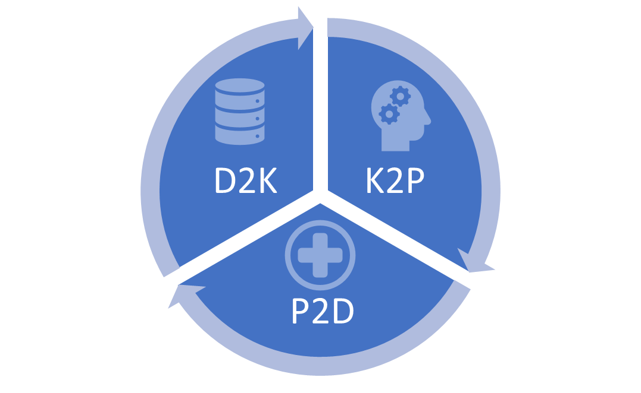
Digital Strategy for Cardiff & Vale UHB
Section One Overview
Section Two Achieving the Vision
  2.1 Achieving the Vision: Stuff
  2.2 Achieving the Vision: Staff
  2.3 Achieving the Vision: Adaptive Change
Section Three Delivery

Slide 3

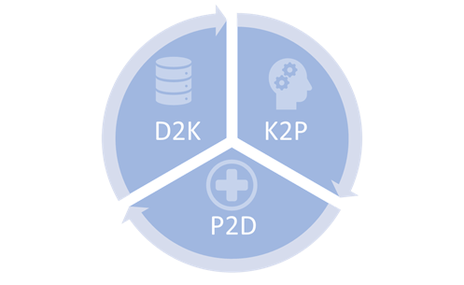
Overview
Our vision,
Our Principles

Slide 4

Introduction
This digital strategy is being produced to provide a clear roadmap for how digital technology will enable the transformation of clinical services described by the Cardiff & Vale University Health Board overarching strategy, ‘Shaping Our Future Well-being’.
The ambition of the NHS in Wales has been set out in the Welsh government document a healthier Wales published in 2018, declaring the ambition for an integrated health and social care system which enables seamless care and the ability to promote health and well-being as close to home as possible. The document very clearly sets out the need for a modern digital infrastructure to enable this transformational change.
The strategy has been written after engagement with staff across the organisation, taking particular note of the attendees of the clinical information management and technology group, the clinical boards, the executive board and information available to us from patient feedback.
The strategy sets out a significant step change in the approach that Cardiff and Vale University health board will take towards a digital future for healthcare services.
Digital services should not be regarded as an end in themselves. The Parliamentary Review into Health and Social Care in Wales, informed by extensive public and service engagement, called for a transformation in the way we deliver services, and this has been accepted by the Welsh Government in the ‘A Healthier Wales’ strategy document. Both recognize that Digital services are a key enabler to transforming the way health and Care services are delivered in Wales, and in enabling patients to have greater involvement in managing their health and well-being.

Slide 5
CTRL-ALT-DEL
Time to reset – Local driver
A staff engagement event (Amplify) in the summer of 2019 to review progress of Shaping Our Future Well-being at its halfway point of five years. A clear message at this event is that many people appreciated the great potential of digital technology to transform our services, but those same people felt that inability to deliver the technology itself and become a significant block to progress.
A similar picture had emerged nationally, and in 2018 the Welsh audit office followed by the public accounts committee delivered to hard-hitting and critical reports into the failure of the health system in Wales to deliver at scale or that piece many of the elements set out in the national digital strategy, informed health and care.
Time to reset – National driver
In 2019 following those national reports, the Welsh government accepted the recommendations of an informatics architecture review, and also announced significant changes to the governance arrangements for the NHS Wales Informatics Service, and the relationship between and the Health Boards and Trusts responsible for delivering services. Importantly, Welsh Government has made available significant increase in funding levels specifically directed towards transformational change, with digital technology as its enabler.
The strategy described here is in line with the architecture review and maintains and updates the direction of travel set out in informed health care.
Digital as an enabler, not a blocker
Notes:
The need for the strategy, its provenance

Slide 6
Our vision:
A Learning Health and Care System
High Level Aims
Digital First for patients and carers
Digital First for staff.
Seamless information sharing across professional and organisational boundaries.
Principles
Co-production through user-centred design
Digital as the enabler, not digital as a goal in itself
Iterative, agile design
Innovation aligned to startegy
Democratise data, democratise knowledge
We are all used to using digital services in many areas of our life – banking, shopping, booking a table at a restaurant, leaving feedback about holiday accommodation etc. Health seems to be lagging compared to all other areas. This is a global phenomenon, and not unique to Wales. Health care is acknowledged by information technology experts to be especially complex, with information having to be shared over a large number of organisational boundaries, and tracking many different types of user-experiences through time. And yet it is possible to deliver and track those services digitally. The Baltic country of Estonia adopted a ‘digital first’ philosophy for its public services, including health, several years ago, and is held up as an international example of what can be achieved.
Closer to home, the UK Government Digital Services has revolutionised the way in which we can now use digital solutions to perform many functions which required extensive paperwork and trips to the post office or other government buildings – renewing a driving license or passport, completing a tax return or applying for state benefits for example.
We set out to adopt a similar ‘digital first’ philosophy for Cardiff and Vale University Health Board, enabling users and staff to use digital technology to access services.
Notes:
Representation of digitally enable workforce and digitally enabled patients

Slide 7
A Learning Health and Care System
Knowledge to Practice
K2P
Practice to Data
P2D
Data to Knowledge
D2K
D2K
By analysing the data we collect it turns into information and knowledge. We can only change and improve our system if we understand it.
K2P
We must then use the understanding we gain to inform , improve and transform practice. This is the most important step, and the hardest to achieve.
P2D
To collect our data, we will need to enable clinicians and patients to record their activities digitally without interfering with the processes of care. Data must be collected and used in ‘real-time’ to maximise its usefulness in operational as well as planning services
By collecting timely, accurate data, we will understand how our system works. We will be able to follow patients through care pathways, learning how we can make them more efficient, and ensuring their journeys are safe.
The ability to collect and record patient outcomes means that we can compare ourselves to other organisations to ensure we are providing good quality outcomes.
By collecting patient reported outcomes we will see what works, and what doesn’t work. This enables us to put Value Based Healthcare into practice.
Notes:
Representation of digitally enable workforce and digitally enabled patients

Slide 8
In 5 years
Patients
Patients will access their own health and care records, reports, and results.
Clinicians
Clinicians will access information about individual patients
Local/National Data Resource
The data collected will be used to build the foundation for a Learning Health and Care System
Our promise
Patients will be able to choose which information to share, and which they do not wish to share.
They will be able to see who else has accessed their information. They will be able to view appointments and re-schedule them via digital channels. They will be able to communicate securely with clinicians providing their care. They will have access to supporting health and care information designed tailored for their needs. They will have the power to share their information with anyone they wish to. They will be able to upload information from wearable devices, or care devices which are part of the ‘Internet of Things’.
They will be able to communicate securely with other members of their clinical team, and in multi-disciplinary teams. They will be able to communicate securely with individual patients and will in many cases be supporting patient care in ‘virtual’ clinics using video communication technology familiar in other walks of life. securely and reliably via digital channels, which will include their own devices.
Timely, high quality data on patient outcomes is used to enable the service to understand what works well, and what needs to be improved. Teams of trained data analysts will work closely with clinicians and service planners to derive knowledge from data. The focus will have moved further towards outcomes rather than the more traditional process measures.
Information will be visible across Wales, and across previous boundaries between primary and secondary care, health and social care, and public and third sector. Appropriate safeguards will ensure personal identifiable data is not shared where it should not be, or where patients have requested it should not be, but the default expectation will be that information will be shared to enable safe continuity of care seamlessly across the system.
Patients will have much more control over how and when they access services, and will be able to access more closer to home
Notes:
Representation of digitally enable workforce and digitally enabled patients

Slide 9
Guiding
Principles
Persistence and re-use of data
Whenever digital information is collected, it will be stored in a form that enables it to be re-used by other appropriate applications. For example, if a patient has had an allergy recorded in a hospital clinic, that information will then be updated and re-used by another application used by a pharmacist, GP or other care provider. This will greatly enhance efficiency and safety.
Co-production through user-centered design
The introduction of a digital process requires and understanding of what it means to the service users – both patients and clinicians. When introducing new digital solutions, patients and clinicians will therefore be involved in deciding what it should look like, where it fits in to their view of the service, and what benefits it might bring.
Digital as the enabler, not digital as a goal in itself
Simply digitising a process seldom brings any benefits. It should instead provide an opportunity to review and change the care process, which will have been established around paper-based processes.
Iterative, agile design
It is tempting to try and do everything at once, and to sponsor large-scale centrally controlled projects to achieve this. The so-called ‘waterfall’ approach does not generally work in digital health care. By the time the required governance and procurement cycles have been worked through, the digital landscape has often changed, and the solution acquired (and committed to) has been superseded. Instead, it is better to break projects down into smaller chunks using small, focused teams working in ‘sprints’ to achieve digital solutions which will be ‘good enough’ (although safe) rather than perfect initially, but which will then be changed in response to user-feedback in an iterative manner.
Innovation aligned to strategy
CAV will continue to foster and encourage innovation, but will ensure that it is aligned with the digital strategy, and that any digital elements of innovation projects fit in with the digital architecture, and are capable of being scaled-up if they prove successful.
Democratise data, democratize knowledge
The data collected by the organisation will produce large pools of ‘big data’ which is the foundation for the learning health system. With appropriate safeguards, this data will be made available to clinicians, managers and analysts across the organization. There are myriad ways of using, visualizing and interpreting data, and even in 5 years we will still only be beginning to understand how to do this. We need therefore to permit multiple stakeholders to innovate in making use of this data and turning it into knowledge. We will not constrain ourselves by assuming there is only one way of interpreting data – there are many mays to the truth!
A system built on data, delivered with care
Notes:
Representation of digitally enable workforce and digitally enabled patients

Slide 10

Achieving the Vision
Stuff, Staff, Adaptive Change

Slide 11
Infrastructure
Desktops and Mobile
Single Sign-On.
Device agnostic.
Bring your own device.
WiFi and networks
Always-on networks ‘The five 9s’: 99.999% uptime
Wi-Fi with full coverage for patients and staff
Wi-Fi roaming
Communications and Messaging
Secure e-mail within Health and Care in Wales, to NHS England
Secure messaging including patient data
Video conferencing within Wales, and with the rest of the UK
Without the basics, nothing else will be possible.
Before going further in this document, the importance of adequate infrastructure has to be highlighted. Without up to date devices, networks and wi-fi, any attempts to digitise the future will fail. We operate, and will always operate, in a resource limited environment. In those circumstances it is often tempting to cut costs in the less visible foundations of our services, and this has included technical equipment, associated staff and cybersecurity. This was recognised in the Welsh Audit Office review of Health Informatics in organisations across Wales in 2018. We recognise that failing to invest in and maintain infrastructure is ultimately counter-productive. It weakens the foundations of our digital system, and without these foundations no sustainable developments can take place. We will have to accept that much of the initial investment in our digital future will be used to address the under-investment of the past. Once that balance is restored, it can’t be allowed to slip again.

Slide 12
Cybersecurity
Security Information and Event Management (SIEM)
- A software solution that aggregates and analyses activity from many different resources across our entire IT infrastructure
Nessus
- A remote security scanning tool
National Cyber Security Centre
- Access to CAV operating systems to monitor and provide support

Slide 13
Information Governance
This section provides a summary of the approach we wish to take to information governance.
Collecting health and care data on patients and service users requires then to trust our organisation to look after their data carefully, ensuring that only those who need to see the data access it, and that we safeguard it against inappropriate access or inappropriate sharing.
Legislation requiring us to do this in terms of common law duty of confidentiality and the general data protection regulation as well as the computer misuse act as an important safeguard for the public’s trust. If we preach these rules we lose the trust of the public, and we will therefore not be able to use the information they share with us to benefit then and the system as a whole.
It is also important that data provided to us by clinicians is shared appropriately. Most patients think that we readily share information between clinicians, teams and other carers involved in providing services, and are often surprised if the discover this is not the case. In the past there has been a tendency to take a very restrictive approach when interpreting data protection legislation.
We need to take note of the general data protection regulation intention which is to enable information to be shared much more easily when it is appropriate to do so, but to give patients and carers the ability to control this without interfering with the processes of care. We are seeking to strengthen our information governance processes, and to ensure that important organisation level decisions about information sharing are taken in a proportionately taking into account both the clinical risks and their information governance risks, and involving legal and patient informed processes.

Slide 14
Digital Inclusion
Mainstream Digital Inclusion
Digital inclusion needs to move from the margins to the mainstream. The Gann report describes how local authorities have been more effective in digital inclusion than health care organisations. We will work with local authority partners to develop a more detailed and a more robust strategic approach to digital inclusion.
Use levers and Enablers
We will ensure that Wi-Fi is available freely across our health and care settings for patients and carers to use. We will invest in the Digital health literacy of our health and care staff to help ensure digital adoption by patients and service users., and frontline staff will be supported to become digital champions for their patients.
Scale Up Inclusion
We will sign up to the Digital Inclusion Charter. Without digital inclusion, the potential benefits of the patient channel work will not be realised. We need to learn from existing initiatives like Digital Communities Wales so we can ensure vulnerable people are not excluded from the benefits of digital.
Improve our knowledge
We will use the framework and tools available in the NHS Digital Inclusion Toolkit, and adopt any similar initiative that is developed in Wales. Even with digital skills and access to technology, people will not use digital health tools if they are not accessible and meaningful to them. Our promotion of user-centred design of all digital health products will include people who are less experienced digital users.
Digital Inclusion is a social determinant of health
Like other inequalities, this means we need to ensure we take steps to address this imbalance so everyone in our community can take advantage of the digital future, and nobody is left disadvantaged
We will adopt the recommendations of the Gann report: 'Digital Inclusion in Health and Care in Wales'.
The Inverse Care Law applies to digital inclusion as it does to other aspects of healthcare. Sections of the population most in need of improved access to health care are also those less likely to be ‘digitally included’.
85% of people in Wales use the internet – that means 15% do not.
Internet use in Wales
People with a long-standing illness or disability 74%
Without disability 90%
Age 65-74 72%
Age 16 – 49 97%

Slide 15

Achieving the Vision
Stuff
How we will build the digital vision

Slide 16








The Digital Architecture: understanding the lingo
Data repository
At the heart of any informatics or digital system is data stored on a computer hard drive, or where there is a lot of data, an array of hard drives (called a server).
Ories. The data held in these drives is usually organised in the form of a database or a collection of databases into which data can be added, removed, rearranged and analysed, either by programmes within the database or separate computer programmes.
Applications
The interface on the computer or mobile device which puts data into these databases or allows the data to be viewed are often called applications.
These applications are sometimes associated with programmes that manipulate the data in the ways described above, but increasingly such programming takes place ‘server side’ making the applications much simpler, and enabling easier ‘plug and play’ potential.
When used on mobile devices, these are usually referred to as ‘apps’.
Application Programme Interfaces (APIs)
These are, in effect, the connections or plugs which allow an application to interact with the data repositories and associated programmes.
Systems
Where a series of databases and applications exist for a particular ‘business domain’, for example pathology laboratories, the collection is referred to as a ‘system’. Each of these individual systems can either be acquired individually in a modular fashion, or as part of a large mega suite of many systems.

Slide 17
The Digital Architecture
Option One: the status quo
Option Two: Megasuite
Once for Wales: modular ‘systems’
An enterprise architecture can be built up gradually, using the best available versions for particular business domains. The disadvantage of this ‘best of breed’ strategy is that the systems are often, in effect written in different languages, and in order to communicate with other systems, translation is required. In the digital world this is referred to as ‘interoperability’. This is complicated by the fact that many of the health organisations in Wales already had some modular systems of their own.
Cardiff and Vale have many dozens of information silos or information systems which have evolved over the years. In order to derive the full benefit of all this data, all of the systems which share information, but this would require very complex and labour-intensive translation. In fact, this requirement is so complex that experts question whether achieving interoperability for a health enterprise architecture in this way is even achievable.
This is broadly the approach that has been taken over the last few years in NHS Wales. This approach sought to either self-build or procure modular ‘systems’ to be implemented, usually as large national level projects rolled out across health boards in a staged fashion. These projects were centrally controlled and co-ordinated, but beset by delays, hampered by differing informatics architecture in different health boards and trusts, differing levels of digital maturity, and differing opinions as to the suitability and need for a given system in each organisation. Local organisations were unable to develop at their own pace, and to address their local priorities, but instead were constrained by a slower, less agile national approach. The Welsh Audit Office and Public Accounts Committee reviews of 2018 were critical of this way of working, and called for change. The architecture review commissioned by Welsh Government and published in 2019 calls for an end to this approach.
One positive benefit of the national level approach has been the ability to share information across health board boundaries, and is the envy of some of our neighbours.
Cerner, Epic, System C…
The second approach described is where a large provider has suite of systems written effectively in the same language and able to communicate with each other, providing digital part for several business domains, such as an electronic health record, electronic prescribing and decision support, and a laboratory system. The disadvantage of this approach is that such systems are very expensive, and even at best the provide less than 50% of the digital components for a typical healthcare organisation. Furthermore, these implementations, which are often called platforms, will generally only communicate with platforms created by the same provider. Thus if you are neighbouring health or care organisation uses a platform from a different provider you will not easily be able to share information, and it takes the service back to the interoperability problem. These can be considered closed platforms. This is an increasing problem for healthcare systems who have implemented mega suites.
This is the approach that has been taken over the past few years in NHS England where mega suite implementations using suppliers such as Cerner, Epic and Lorenzo have been implemented in the most digitally mature organisations (i.e. those with the infrastructure to support them), so called Global Digital Exemplar organisations and latterly, Fast Followers.

Slide 18
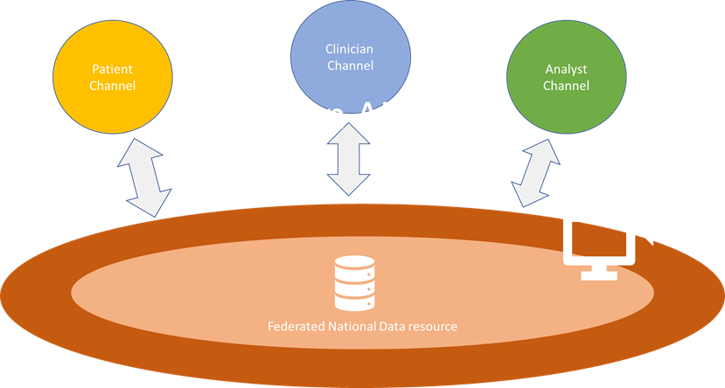
The Digital Architecture
Option three: Open Platform
What is an Open Platform?
The approach advocated by the architecture review is based upon the concept of an open platform. In this central collection of data is maintained according to a set of strict information and technical standards. This is particularly important because by ensuring that everything is recorded and described in the same way, and stored in the same format, the information can be retrieved and used reliably without the interoperability problems discussed above.
Mandated standards
The information platform can be imagined to be surrounded by a series of interfaces or virtual plugs the application program interfaces (APIs). These enable applications to contribute, view and analyse data in the way described above in applications integrated with other systems. However, the applications in this model are not specific to a particular system, but rather conform to the data and technical standards of the platform. This makes the process of introducing new applications when they emerge, and replacing old ones when they are superseded much easier.
Encourage innovation
By making the APIs open to trusted organisations and trusted suppliers, they can develop applications much more quickly and easily to the benefit of the service. This enables a flexible and agile approach for how our organisation and others in Wales collect, view and analyse patient information. The APIs can be designed to communicate with devices such as fitness trackers, heart rate monitors, medication pumps et cetera so that data can be provided in real-time without the need for staff for patients to input anything themselves. Much of the growth in the wider Digital Economy has occurred because suppliers have made their APIs ‘open’.
The ‘Single’ Electronic Health and Care Record
The data collected on this platform can be used to inform individual patient care, as each element of data is identified as belonging to a unique patient, in this way you can see that the concept of a single electronic health record becomes difficult to visualise, because over time so much information and data could be gathered not just from individual interactions in clinic or hospital admissions in the way that traditional hospital wards are, but including information recorded on monitoring devices as described above. The single electronic health record actually becomes an enormous collection of data which can be visualised in a number of different ways according to the application suitable for the purpose at hand.
Open, but not uncontrolled
Health data includes sensitive personally identifiable information. It is important to be clear that what is meant by ‘open APIs’ is that the configuration of these virtual plugs is made available only to developers of products who are trusted to hold such data by satisfying strict Information Governance requirements, and stringent Cyber-security standards. The APIs being ‘Open’ means that if they have achieved this status, they can design their solutions consistently with APIs made available to them, which increases the speed at which solutions can be developed.

Slide 19

Clinician Channel
The ‘Electronic Health Record’
Applications used by clinicians to view results and reports, record clinical interactions and procedures, view images, prescribe medications, communicate with other clinicians.
Patient Channel
The ‘Personal Health Record’
Applications used by patients to book appointments, view results and reports, record outcomes, communicate with clinicians.
In effect, this creates a personal health and care record. Patients may upload information in symptom diaries, data from wearable health and fitness devices, and may choose to share some or all of this with clinicians providing their care.
Analyst Channel
Data to Knowledge
The applications which can intersact with data at various levels of aggregation from individual to population level which enable data to be turned into knowledge to understand, learn from and re-design the system.
Data Resource
Persistent and re-usable data
This is the pool of data held in accordance with strict information and technical standards so that it can be understood by and interact with applications via APIs . It is supported by an infrastructure that ensures its security.
It’s physical location. The resource will actually comprise several ‘local’ data resources created by Health Boards and Trusts together with some nationally hosted resources – a so-called federated model. Although physically disparate, they exist in a single ‘cloud’ architecture.
Bear in mind that these ‘Channels’ are a conceptual representation to help understand how things fit together. In reality, many applications will overlap in terms of the users.

Slide 20
Once for Wales?
‘Once for Wales’
Information and Technical Standards
Cybersecurity standards
Information Governance Standards
Electronic Master Patient Index
Electronic Staff Index
Local or Regional
Applications in the three channels
Alignment to National Strategy
One of the reasons highlighted in the Welsh Audit Office report of 2018 as leading to a lack of pace and scale in digital implementation in the Welsh health service relates to numerous attempts to ensure our Once for Wales approach to large systems.
Lessons from abroad, lessons from home
It was clearly very attractive to think that for particular business domains one system across the country could be implemented very easily and with rapid agreement. This approach has been demonstrated in health systems across the world to be very difficult or impossible to achieve. The reality is that all organisations are at a different point in their digital journeys, and some have good systems for one business domain, and pure systems for another, but these won’t necessarily correspond to those of the neighbours. The open platform approach requires that everyone agrees to provide information using the same standards and using the same technical organisation structure for the data, but leaves organisations free to source their own applications in a forum and at a time that suits them, and doesn’t interfere with the operation of any other organisation.
Cultivate collaboration, mandate sparingly
Of course it may be the case that because applications become smaller and easier to design using open APIs, it may be easier to reach a national agreement to use a particular application for a particular business domain where there is a shared need and shared opinions, but importantly it need not be a mandatory requirement. Collaboration is probably more likely to occur as these applications, and the markets around them evolve in the next few years, but while that process is taking place it makes more sense to allow some flexibility at local and regional level.
Because of the importance that information in the platform is effectively written in the same language as explained previously, then it becomes very important that organisations agree to adhere to the information standards and the technical standards describing how that information is organised. It therefore means that once for Wales means the platform in the middle, but doesn’t necessarily mean the applications around the outside.
Working with our neighbours
Some of the elements required to build a Digital First approach may be more efficiently achieved by collaborating with our regional neighbours in Aneurin Bevan Health Board, Velindre NHS Trust and Cwm Taf University Health Board.
We will seek to build close working relationships around shared infrastructure, and seek to share learning with these organisations.

Slide 21
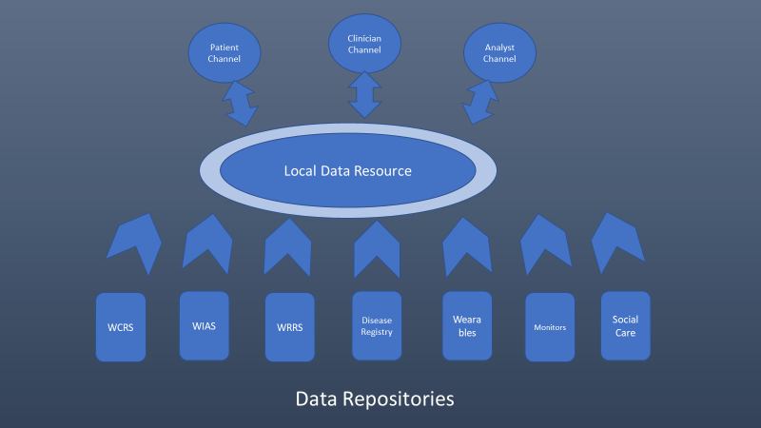

Local and National Data Resource
Building a Local Data Resource
Legacy data
In order to build a useful local data resource, which will in turn become part of the national data resource we need to make data we currently hold in individual data repositories available. This is not a simple matter of ‘emptying’ data into a new set of databases, unfortunately. The data needs to be ‘translated’ into a form that makes it available in a standardised format. This is called making the data ‘interoperable’. This makes the data available to applications in the three channels referred to earlier.
The widely adopted standard for interoperability across health systems is called Fast Healthcare Interoperability Resource (FHIR) – pronounced ‘fire’.
We will need to procure FHIR servers to store this data, and undertake work to convert legacy data into this format. This data varies from large stores of clinic letters, to smaller disease registers and bespoke team-specific databases.
New data
The disjointed silos of information we now seek to harmonise must be avoided in the future. Our strategy will be to avoid the creation of any information silos, and instead require that the data is FHIR compliant, and this will be essential for any third-party suppliers to comply with.
Open EHR
We will also look more favourably on products that use the Open Electronic Health Record structure. Using this approach, the data is effectively placed straight into the data resource without the need for translation.
Clinic Letters
Primary Care Records
Laboratory Results
FHIR

Slide 22
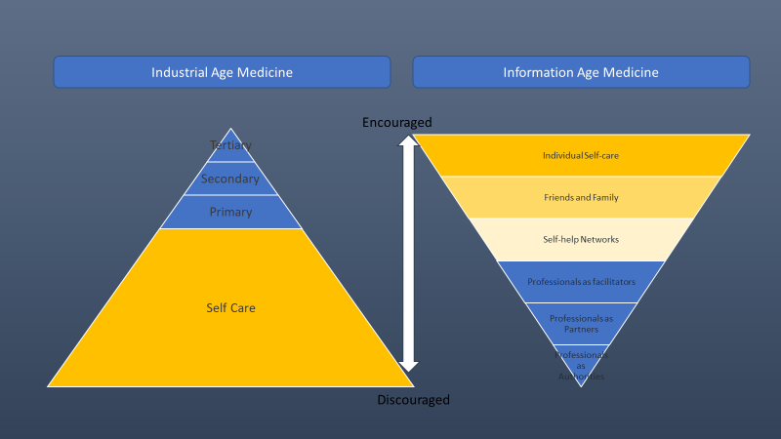
Patient Channel
What will patients be able to do?
We want to allow patients to access test results without needing to come to clinic or to phone a service desk. We want them to be able to book and change appointments, record their outcomes (Patient Recorded Outcome Measures) and experiences (Patient Recorded Experience Measures).
They will be able to give access to carers or relatives, as they wish, and to be able to see who has access to their data.
There will be some information which it is inappropriate to share online, and where it may be harmful to see results without a face to face explanation, they can still be hidden, so the applications we use will need to allow some control of sharing from the clinician’s as well as the patient’s side.
National Patient Portal
We will collaborate with the national Patient Portal programme, which will provide a single secure portal which authenticates a patient’s identity, and then allows access to various applications providing some of the functions mentioned. There will be more which evolve in future, and we will want to enable flexibility in enabling many applications to address functions which serve patient care as they become available.
But we don’t have to wait until the portal is developed – we can go ahead and start to use some available applications in the meantime, using the principles described for the open platform approach.
Giving patients control
A famous diagram represented on this page shows Tom Ferguson’s inverted triangles model when he forecast the likely effect of technological advances on patients’ expectations of care.
This is entirely aligned to Prudent Health Care principles, and the strategy described in A Healthier Wales of enabling care closer to home, and providing support for patient’s to maximise their well-being.
By allowing patients the ability to control their own journeys through healthcare, they benefit, and the whole system benefits. We can start to re-shape outpatient services such that patients are seen only when they need to be seen, and enabling interactions to take place remotely using video communication.

Slide 23
Clinician Channel
Viewing data
Clinicians must be able to see comprehensive information to inform the best care decisions for their patients. This will include information from their GP and community services, different secondary care settings, social care and third sector organisations. Many of our services are provided across a regional or National footprint, so the information must be visible across health board boundaries. 30% of our organisation work in the community, and it is vital that they can access this information via mobile devices. We know that increasingly our challenges relate to patients with multiple conditions, and in this group, care information is created in a large numbers of different settings.
Many patients would expect that we already allow information to flow seamlessly across these boundaries, and it is starting to. By putting our information onto one platform based on a Local and National Data Resource we can achieve this for everything.
We are already good at sharing clinical information, including laboratory results, clinical letters and reports and radiology images across health boards. We share images across primary care to secondary in Dermatology, and images of eye-conditions taken by local optometry services with secondary care ophthalmology services, but these are still pockets of digitally-enabled care rather than mainstream. We need to ensure that where such initiatives have proven successful, they will be scaled-up. This will be helped by improving our business change processes to ensure appropriate evaluation of project success, and also by describing scale up plans (and resource) in development cases.
Electronic Patient Record for Secondary Care
Community Care Record
Mental Health Care Record
Social Prescribing
Patient observations
Electronic prescribing

Slide 24
Clinician Channel
Entering data
Although we are getting better at sharing data across boundaries, that data is often not ‘rich’. Much of our clinical information is held in the forms of clinical letters and discharge summaries. The information contained in these ‘flat files’ is not available to a computer to use – it needs to be read by a human being. All a computer can see is a document title, and some other coded information attached to it as ‘metadata’. Our Patient Management System (PMS) records some information in a coded way where each item of data can be ‘computed’. This is only a fraction of the clinically meaningful data we should be collecting, and in fact most of it is demographic content and a description of ‘episodes’ (admission, discharge, new clinic visit etc.). We Also know that even this small amount of data is not always correctly ‘coded’, and provided in a form that computers can do useful tasks with it, and we know that a lot of this coded information is incorrect. This, in turn makes information derived from it inaccurate or misleading.
We need to collect much richer data, we need it to be more accurate. We can do so by using a ‘virtuous circle’ effect of making data more visible. By improving the detail in information we ‘code’ (i.e. put into computable form), we will need to ensure it is entered in ‘real-time, not as a bulk exercise from memory at a later time. This requires much more readily available devices to enter the data – but that also makes it easier to see pre-existing data. Because we will be using a platform around the national data resource, information which already exists (demographics, medicines, allergies, advanced care plans, problem lists), fields in data entry applications can be ready-populated making the update process more efficient. The process of real-time data entry will make the data more accurate.
Aggregated information will be available to clinical teams, and because this information is timely, any inaccuracies can be corrected quickly, and the data become useful. Much time currently is spent trying to derive information from data that we know is unreliable – over the period of this strategy, the quality of data will be driven up, its usefulness will be driven up, and the conversation will move away from disputing the data’s accuracy, and onto converting what the data says into knowledge.
The importance of coding
Making sure that information is recorded in a consistent way, and that each data item’s meaning is interpreted correctly across applications, we need to fully implement the SNOMED-CT system. This stands for Systematised Nomenclature of Medical and Clinical Terms, and is the international standard, and has been formally adopted by the NHS in all Home Nations. Any systems we implement to act as data entry points to the Local and National Data Resource will need to have SNOMED-CT capabilities, and we will be working with local projects and with NWIS to enable this. Clinicians using the system will be able to pick from bespoke lists of commonly used terms to speed up data entry. The advantage of SNOMED-CT comes when data is aggregated, and clinicians want to understand features of patients with the same diagnosis, groups of diagnoses, particular procedures etc. It’s hierarchical and conceptual nature will revolutionise how individual clinical team members can start to do their own exploration work for their patient groups, and it will greatly improve how the system can learn. For a better explanation of some of the detail see the NHS Digital website. For a simple animated explanation try this from NWIS

Slide 25
Clinician Channel
The electronic patient record (EPR)
For most of our clinical users in secondary care, a big gap in our digital capability is the ‘front end’ for putting this coded information into the LDR/CDR. We have some ability to put information in via either Welsh Clinical Portal and CAV portal, and some bespoke systems which input particular clinical-service information, often as part of a disease registry. In Mental Health and Community services we do have better functionality using PARIS, and we will evolve to contribute information collected in this way into a Welsh Community Care Information System (WCCIS).
Our strategy will be to develop a single entry portal where clinical information can be entered via any device from any location, but behind this portal the user will have the ability to access the information most important to them for a particular type of clinical interaction. This will involve a library of applications bespoke to particular user-requirements, but for the clinical user it will simply appear as one single interface, and will avoid the need to log in to multiple ‘systems’. This may or may not be Welsh Clinical Portal. The Architecture review requires that some work is done to ‘re-platform’ WCP to enable they type of arrangement just described, but it would also enable the use of another portal providing exactly the same functionality, giving us a choice as an organisation to adopt the interface our users prefer.
We are already starting to develop such a ‘front-end’ EPR for use in outpatients, currently called COM-2. It uses SNOMED-CT, and provides and retrieves data stored in the appropriate standards for the LDR/NDR.
Further into the future
This is a very rapidly evolving area. We know from health care systems that have had long-standing EPRs that the clinical users are not always in love with them. There is a feeling that the computer can start to come between the clinician and the patient. In the USA, hospitals have begun to employ teams of ‘medical scribes’ who record and enter information on behalf of clinicians who are better able to converse and make eye-contact with their patients rather than their computer screens. This is not a viable long term solution, but another emerging digital technology is. Natural Language Processing (NLP) is a use of machine learning/artificial intelligence algorithms which can ‘listen’ to a conversation and ‘understand’ what is being discussed, and what the outcomes are. If the current pace of evolution continues, then NLP may become our data entry assistants. We will continue to watch this space.

Slide 26
Analyst Channel
1. The learning health system
2. Outcomes over process
3. Analysts and data science working closely with clinicians
4. A ‘learning’ environment
5. Partnership with Universities and Industry
in this section talk about the fact that data is the most important way in which would be able to understand the services that we provide, whether being provided well whether the being provided in a timely fashion and whether the outcomes of good. The conversation here about how we make business systems visible to all clinicians across the organisation and there is a conversation about how we maximise the benefit of modern business informatics systems to generally automatic reports as well as self-service stuff
We also need to have a discussion in this section about the fact that telling the data into information is extremely important, but is quite difficult. That involves four relatively basic data good visualisation and an ability to have informed conversation with clinical users who actually unable to interpret what might be going on to explain some of the patterns described in the information.
Beyond this we need to make point that artificial intelligence requires data as its fuel and its only with this data resource that will be able to fully benefit from a high as it evolves.
WE NEED TO TALK ABOUT AI
This will be a short section emphasizing that AI is something to embrace, not fear.
Sometimes we are already using it because applications may be engineered using AI or Machine Learning.
The substrate for AI that we want to develop ourselves and with partners is good quality data held in a computable format. That is largely only available for images currently – we need to move to a world where it can be true of other clinical information recorded during care episodes.

Slide 27


Turning data into knowledge
Visualisation
Exploratory analysis
Feature selection
Mapping
Data doesn’t turn into knowledge by magic. It is a process. It starts with good quality data, and requires people with different skill sets to visualise and explore patterns in the data. Features of interest may then be studied, and statistical learning techniques applied to this data to turn it into knowledge, and enable a deeper understanding of what happens to our patients, and of the services we offer. This requires clinicians working closely on a data to day basis with data analysts.
At it’s most advanced level, the so-called ‘statistical learning techniques’ include machine learning, deep learning and artificial intelligence.
Currently we do visualisation, but then tend to jump straight to the end of the process, assuming we have understood the data and turned it into knowledge. For example, we look at historical activity data and extrapolate it to ‘forecast’ the future. This has utility, but is only scratching the surface of what we could do.
Quality ‘real time’ data
An electronic health and care record
Structured data
Local and National Data Resource
Analytic capability and capacity
Analysts
Clinicians to work with analysts
University partners
Industry partners

Slide 28

Achieving the Vision
Staff
Who will build the Digital Future?

Slide 29
Wachter principles
It’s about the people, stupid
Dr Robert Wachter’s seminal report into the failure of NPfIT in England established ten basic principles to learn from. We recognise that these lessons are not unique to England, but are generic, and apply to Health and Social Care digitalisation in Wales as elsewhere.
The overarching message from this report is the essential need for clinical engagement in the process of digital transformation.
Digitise for the Correct Reasons.
Don’t digitise for the sake of it – digitise to re-imagine how things can be done
It is Better to Get Digitisation Right Than to Do it Quickly
Balance the immediate operational drivers with the overall strategic aim.
Return on Investment from Digitisation Is Not Just Financial
There is a productivity paradox. It will take time to bed-in, it will take to transform – be patient, and evaluate against more than the bottom line
Balance appropriately between local/ regional control and engagement versus centralisation.
Standardise the central architecture, but allow organisations and teams to innovate and set their own pace and prioirities
Interoperability Should be Built in from the Start
Today’s solution is tomorrow’s legacy. We know that our information systems need to speak the same language, so don’t make life difficult for those who will inherit what we create.
While Privacy is Very Important, So Too is Data Sharing
Information Governance Legislation (GDPR) has been introduced to encourage sharing of data safely and securely, not hinder it. Patients expect us to share their information to enable seamless, safe, efficient care.
Health IT Systems Must Embrace User-Centered Design
Start from the patient’s perspective, and involve patients in re-designing systems.
Going Live With a Health IT System is the Beginning, Not the End.
This is probably the most common mistake, and the biggest contributor to failed digital implementations. Digital solutions only work when people understand them, can use them, and know what they can enable – and that involves time and effort.
A Successful Digital Strategy Must be Multifaceted, and Requires Workforce Development
If we want our users to benefit from digital solutions, our staff have to be enabled to use them. If we want to build a Learning Health System, we need to train and retain staff to analyse and derive knowledge from the data we collect.
Health IT Entails Both Technical and Adaptive Change
Health and care systems are complex. Technical fixes alone cannot solve their problems. Staff and users must be able to transform the way they interact with services to achieve the quadruple aim of health and care. Clinical engagement is the key.
Notes:
Wachter Principles

Slide 30
The Digital Team
How the team is structured

Slide 31
Cardiff and Vale Digital Governance Structures
Funding Bodies
1
Services
Commissioners
Local Authorities - TBC
Strategic Direction Setting
North West London STP Governance Structure
Clinical Boards
HSMB (IMTPs)
Business Case Group
National Initiatives (W.G)
Local Authority
Cabinets
Health & Wellbeing Boards (Future Model)
Programmes / Enablers
Examples only
2
Regional Digital Collaboration Board
(Future Model)
DA2
Better care for people with long-term conditions
DA4
Primary Care Sustainability
DA6
Community, Mental Health Digitisation
DA1
Mobilising the workforce
DA3
Digital Citizen / Health and Care Portal
DA5
Efficient Outpatient Services
DA7
Record platform & Advanced Analytics
Workforce Transformation Delivery Board
(HR)
Design and Delivery Groups
3
Digital Management Board (DMB)
Technical Design Authority
Information Governance Group
Workflows and Interoperability Group
How digital is managed, co-ordinated and strategically aligned

Slide 32

Achieving the Vision
Adaptive Change
Using digital to transform the future

Slide 33
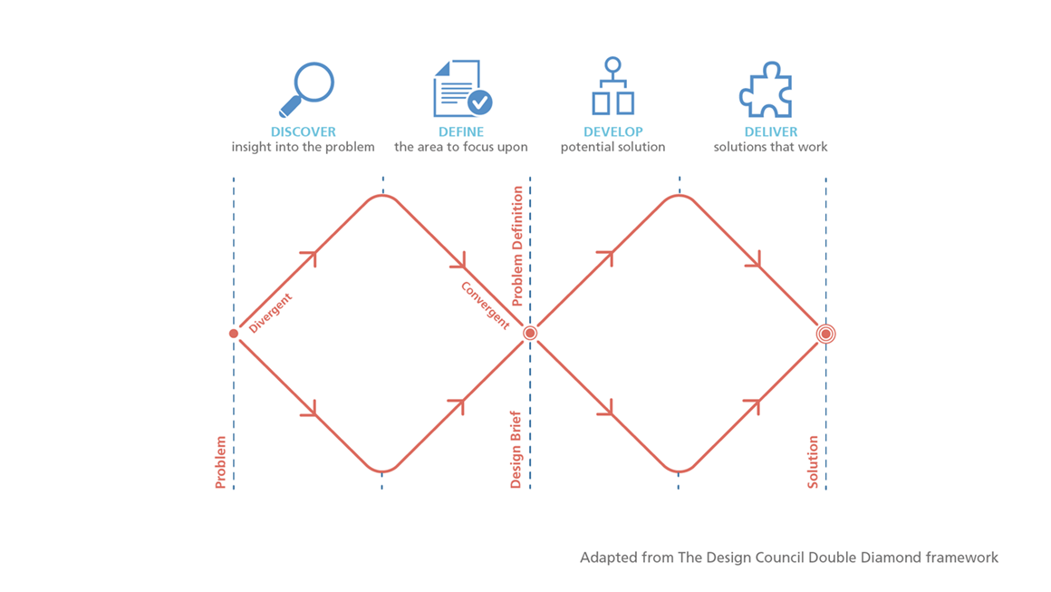
Design Principles

Slide 34
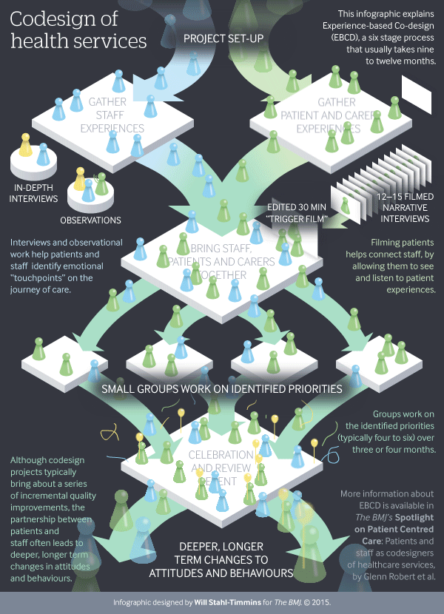

Slide 35
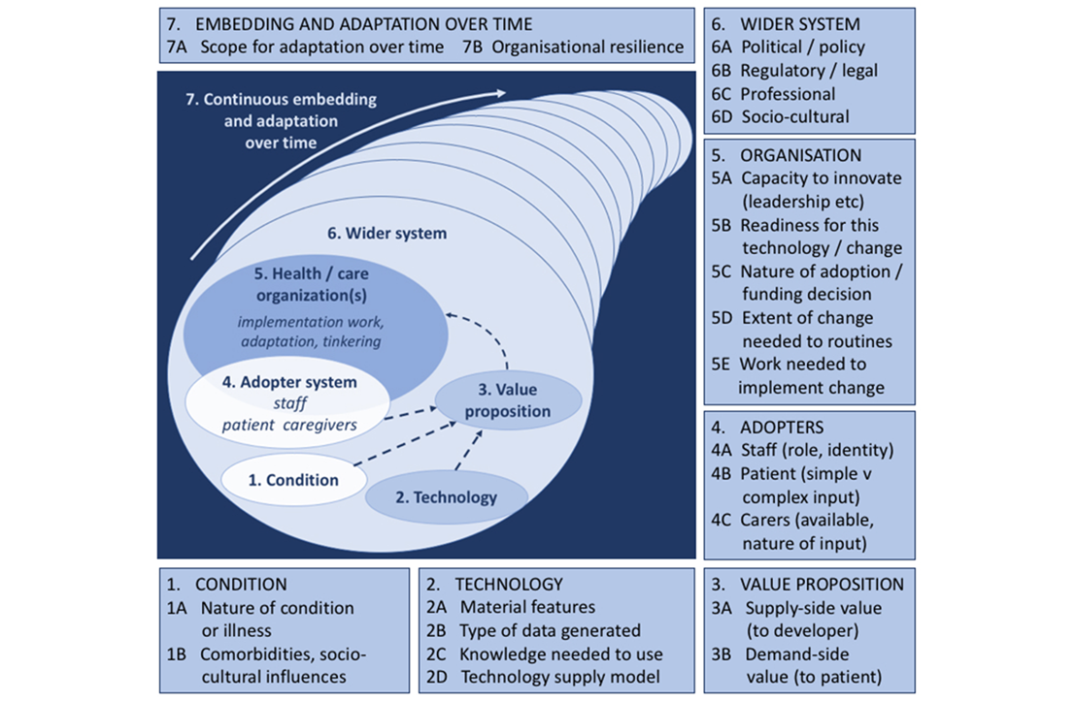
Evaluation

